Slide 1

Welcome to
Meadgate Primary School
EYFS Induction
Thursday 26th June 2025
Notes:
Welcome, thank you for coming, introduction of adults

Slide 2

Transition to School
Thursday 26th June 6:45pm – Welcome meeting for parents/carers
Friday 27th June 2-2:45pm – Teddy Bear’s Picnic – School field
Monday 7th July 10:30-11:30am - GROUP A Stay and Play
Monday 7th July 1:30-2:30pm – GROUP B Stay and Play
Tuesday 8th –Thursday 10th July – Nursery visits
Notes:
Has all gone out on letters home but just as a reminder. For Stay and Plays drop off at gate, explain why – explain tea/coffee/chat to other parents etc. Parents to stay with child for mini picnic – fun chance to be together, bring teddy, small snack and drink, bookbags will be given and a book to borrow over the summer. Explain about nursery visits and these are not set in stone, don’t usually attend etc. Appointment slips will be given on Monday 7th July. Any problems, phone office before end of term (18th July)

Slide 3
School Induction
Wednesday 3rd and Thursday 4th September – 1:1 Parent/Teacher consultations
Friday 5th and Monday 8th September – Settling sessions AM/PM
Tuesday 9th September (9am - 1:15pm) – Settling in morning + lunch (Both groups)
Lunch will be provided from Tuesday 9th September but they can bring a packed lunch from home if they prefer ☺
From Wednesday 10th September 8:45-3:05 - All children to attend full time
Notes:
Quick information on consultation and why this is important, have you signed up? Appointment slips sent home Monday 7th July. Lunch menus are available on our website so you can check whether your child will like the meal that day. Any questions regarding above?

Slide 4
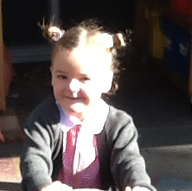
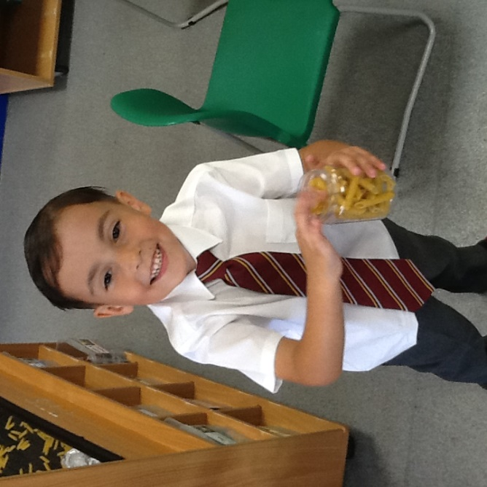
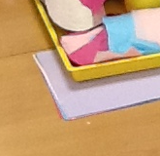
We want your child to…
Be happy!
Be independent
Form positive relationships
Develop a love of learning
Make good progress
Notes:
These are our number one priorities. Happy, safe, welcomed. First few weeks will be settling in, getting to know each other, class routines and rules and this is vital throughout the year. We put relationships first – we really value parents as partners – come back to this in a while

Slide 5
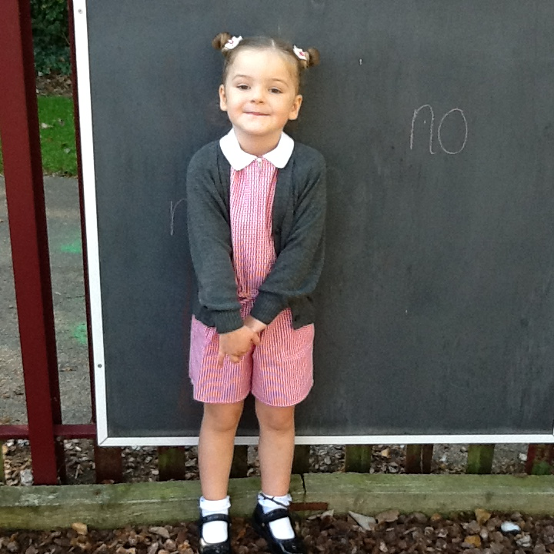
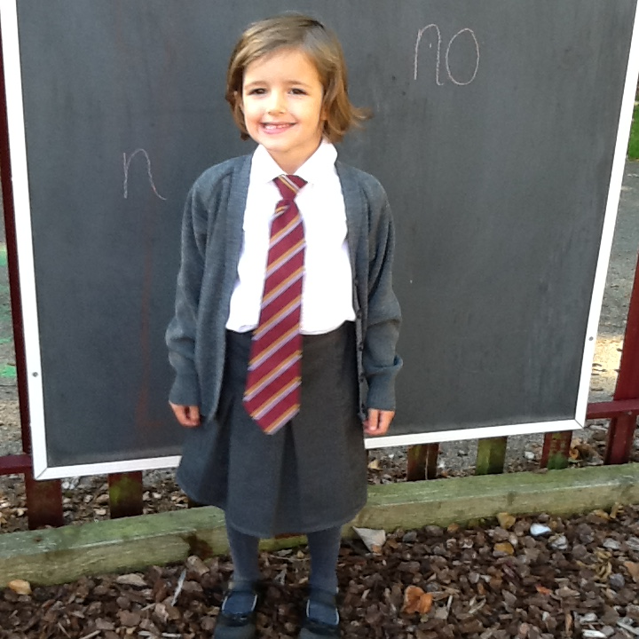
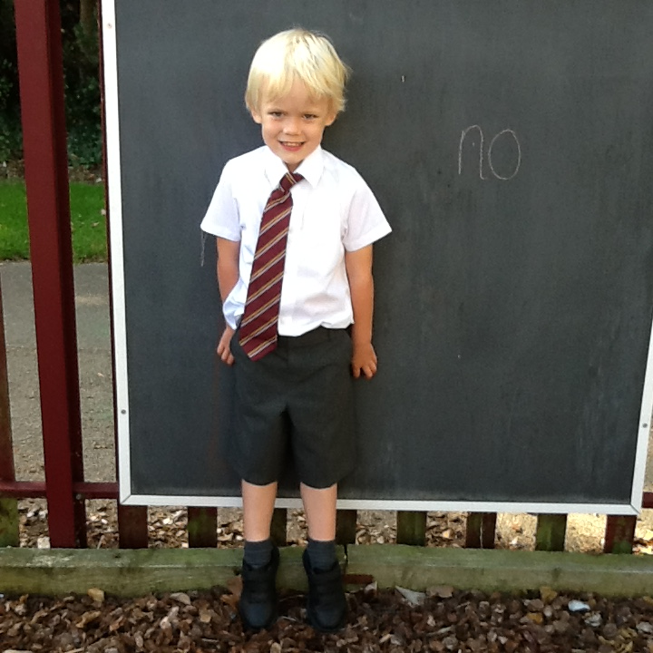





School Uniform and PE Kit
Please ensure everything that comes into school is named!
Our PE day is Friday ☺
Notes:
School uniform can be bought from the One Stop shop on Beehive Lane. Although some things need the school logo/pattern e.g. tie/jumper – you can find cheap alternatives for shirts etc. in supermarkets. Please make sure you buy clip on tie – h&s. We would recommend these due to the active, messy, fun learning we do in Reception! Please ensure everything is named. Things get lost, more likely to be returned etc.
PE day – Friday. PE kits will stay in school and sent home half termly for a good wash. Can include trackies/jumper for cold weather but please make sure these are in line with school uniform. Earrings out on PE days and hair tied back. Velcro shoes. PTA have a pre-loved uniform shop which you can peruse on Monday 7th July if you stay for tea/coffee while children in stay and play.

Slide 6
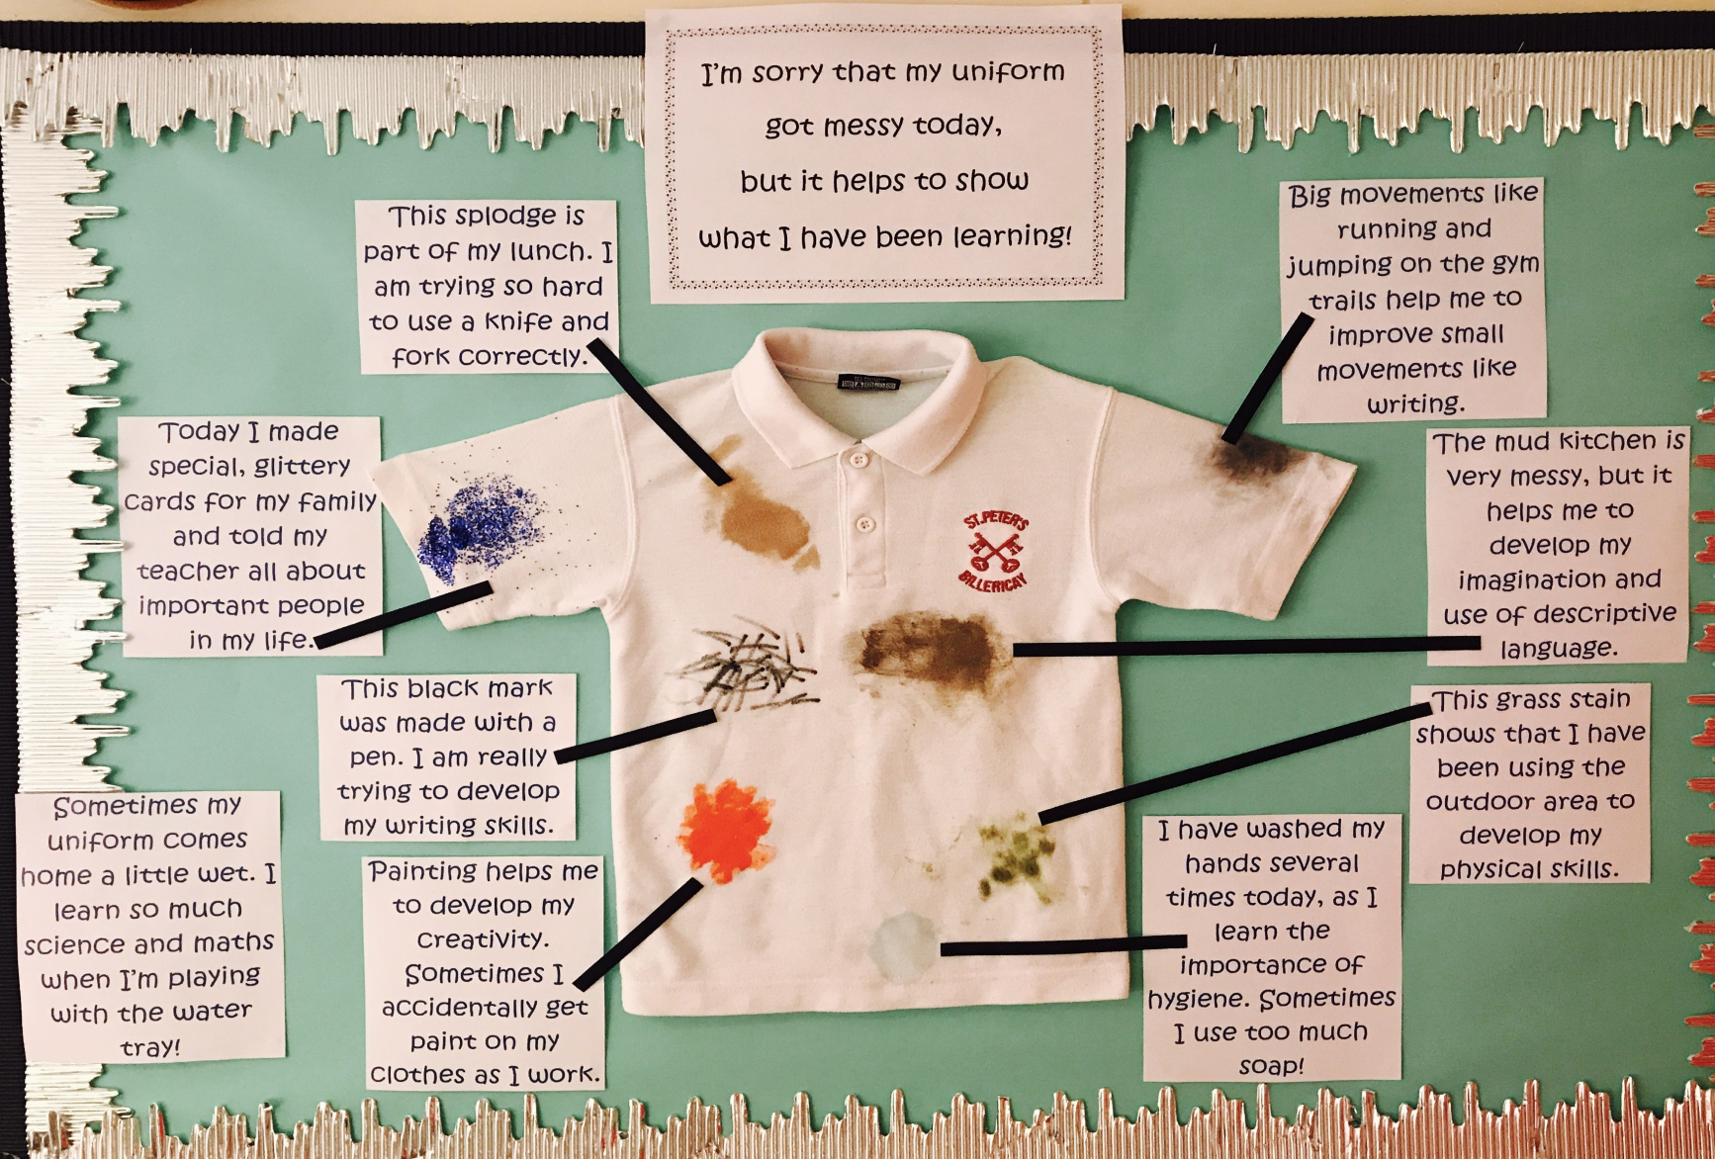
Learning can be messy!
Notes:
Discuss mess, we understand it’s frustrating when uniform gets messy but messy play is vital to chn’s learning and development. We try to keep them clean and dry but sometimes this is impossible – they are children and they will get dirty. Teaching your child how to change their shoes/put on a coat etc. will help with this.

Slide 7

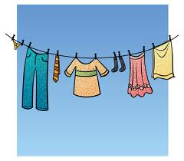

Things to bring to school
Book Bag (with reading book and log everyday)
Water bottle (water only please)
PE kit
Packed lunch (from 9.9 if not having a school lunch)
Spare uniform and underwear (if necessary for your child)
Wellies (to leave in school)
A big smile! ☺
Please ensure everything that comes into school is named!
Notes:
Just one bag please unless bringing something extra for a particular reason – too much for them to carry. Not too much in their lunchbox.

Slide 8


Parents as partners
How do I share information about my child with the school?
Sickness/absence: phone the school office on the first morning of absence
Medical history/medication: hand in to the school office and fill out a form. No medicine in book bags
Need to pass on a quick and important message: speak to the Class Teacher or one of the class LSAs on the gate before or after school.
Require a longer appointment with the class teacher: phone the school office or send an email to admin@meadgate.essex.sch.uk to request appointment
Sharing WOW moments from home: fill in WOW stars or contact via Class Dojo
Notes:
Really important to keep us updated of allergies/dietary needs– we taste lots of food in Reception!

Slide 9

Parents as partners
How will the school share information with me?
Need to pass on a quick and important message: we may speak to you on the gate before or after school.
Bumped head or injury: will receive a note in book bag for any minor head injuries, if we’re worried we’ll always let you know
Class learning: regular class updates will be uploaded to Class Dojo
Discuss individual progress: you will be invited to parent/teacher consultations (usually twice per academic year) and will receive an End of Year report

Slide 10
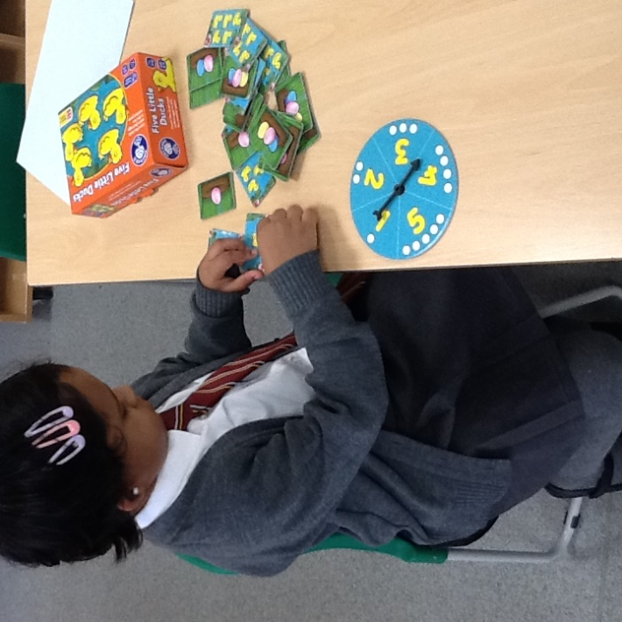
What is the EYFS?
Early Years Foundation Stage (EYFS)
  Learning and development stages for children from 0-5 years
  Curriculum for nurseries/pre-schools and Reception
  End of year – assessed against 17 Early Learning Goals (ELGs)
Based on the knowledge that young children learn best through:
  Playing
  Exploring
  Being active
  Creating
  Asking questions
Notes:
Playing and active learning is really important, it prepares children for their future successes and learning through the rest of their school years and beyond. It is age-appropriate and vital to child development and progress. Most of the day is play-based with carpet time for specific, direct teaching. Need to meet their 1st 12 ELGs to get GLD

Slide 11
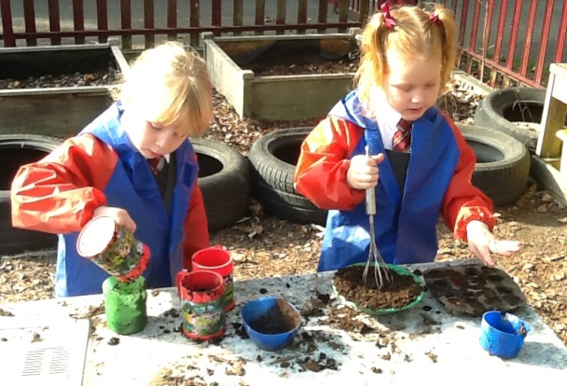
What will the children be learning?
In the first few weeks…
getting to know the environment, the adults in their class and each other as well as rules and routines
we will be finding out what the children already know and can do and what they need support with
we will be planning next steps for the class as a whole, groups and individuals
Statutory baseline assessment

Slide 12

Reading at School
How will my child learn to read at school?
Learning to read can essentially be broken down into two parts: word reading + comprehension
We will work on both through many methods including; daily phonics lessons and activities (learning letters and the sounds they make), daily group and class story times, class comprehension sessions and individual reading
Every child will read individually with an adult in school at least once per week and their progress will be recorded in their reading record

Slide 13
Reading at Home
How can I support my child with reading at home?
Children will bring their new books home on a Friday so they can share it with an adult over the weekend and during the following week. Books will be collected in on a Thursday – they won’t come home that day
New books will contain the new sounds we have been learning that week
Please write any comments you may have about your child’s reading in their reading record. We will check these weekly
All children will start on a lilac level book; no words. We will then progress to pink books which will include letter sounds
Top tip for lilac level: talk to your child about the pictures. Do they understand what is happening in the story? Can they predict what will happen next? How do they think the characters are feeling?
Little and often is best ☺
Notes:
Lilac books - these books have no words and are to help children to tell a story and explain the pictures without the pressures of decoding at this stage. Each child will be moved on to the next reading colour when they are individually ready for a new challenge
We know parents are busy and we don’t expect you to read reams every day or always write in your child’s reading record book BUT reading at home is vital to your child’s development
Summer reading challenge at library

Slide 14

Top Tips for the Summer
How can I get my child “school ready”?
Talk about school and prepare for this change together
Encourage them to ask for what they need
Practise using the toilet and washing hands
Practise getting dressed and undressed
Share books together and talk about your favourite pages
Practise recognising their own name and where to find their name label on their belongings
Notes:
Great books in local libraries about starting school. You can ask for a ‘starting school bag’
Practise lots of skills for independence, they will have to share adults more than before so will need to get used to doing more on their own

Slide 15
Key People
Mr Figg (Head Teacher and Deputy CEO of the Trust)
Ms Meager (Head of School)
Mrs North (Reception Class Teacher, Mon-Wed)
Mrs Morton (Reception Class Teacher, Thurs -Fri)
Mrs Tinham (Learning Support Assistant & Midday Assistant)
Miss Bury (Office Manager)
Miss Scully (Admin Assistant)
Mrs Ing (SENCO)

Slide 16
If you ever have any questions, please don’t hesitate to ask us in person, by email or over the phone…
☺
Notes:
We’d always rather you come and speak to us. We try our best but only human so you might think of something we’ve missed. Any questions from today?

