Slide 1
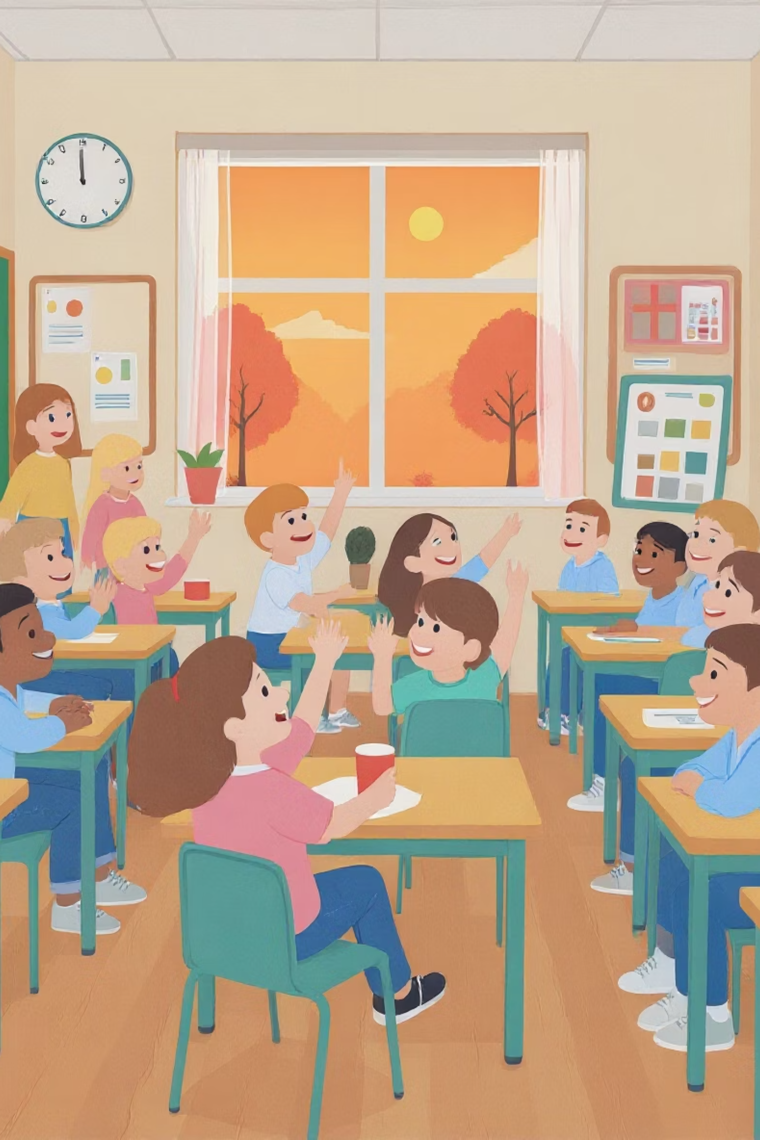
Welcome to Year 3!
Parent Information Session
Welcome to an exciting new chapter in your child's educational journey!
Year 3 marks a significant milestone where children develop greater independence, tackle more challenging concepts, and build confidence in their abilities. We are delighted to share what lies ahead and how we can work together to support your child's continued success.

Slide 2
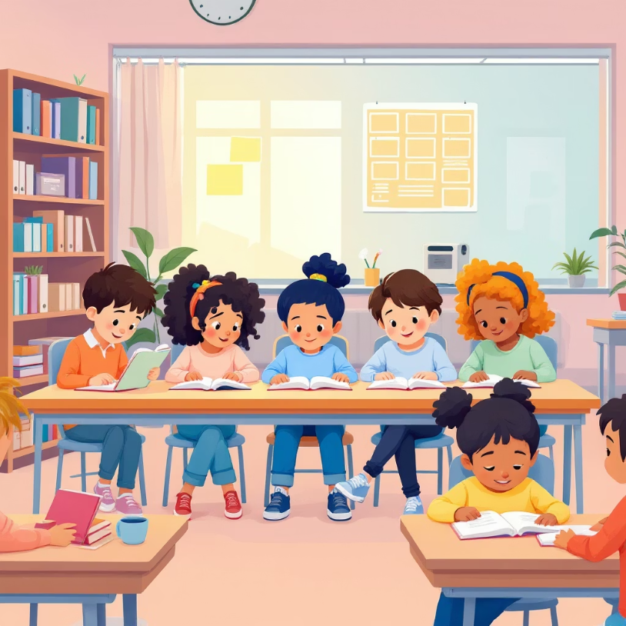
What is Year 3?
Year 3 represents a pivotal transition in your child's primary education. Often called the 'bridge year,' it connects the foundation learning of Key Stage 1 with the more structured approach of Key Stage 2. Most children are now ready to embrace greater academic challenges whilst developing crucial life skills.
This year focuses on building resilience, fostering curiosity, and encouraging children to become confident, independent learners. Creativity is just as important as the core subjects, ensuring a well-rounded educational experience that prepares them for the years ahead.

Slide 3




Expectations in Year 3
Your child will develop essential skills and attitudes that form the foundation for their future learning success. These expectations help build character and prepare them for increased independence.
Responsibility for Belongings
Independence in Organisation
Children learn to organise their school bag, remember PE and swimming kits, and take care of reading books and reading logs. This builds essential life skills and personal accountability.
Students gradually manage their daily routines and complete some tasks with minimal adult support, fostering confidence and self-reliance.
Collaborative Working
Positive Behaviour & Respect
Pupils develop teamwork skills through group projects, peer discussions, and shared problem-solving activities that enhance social learning.
It is important to nurture mutual respect, kindness, and understanding, creating a supportive environment where every child can thrive and feel valued.

Slide 4




Homework
Times Table Practice
Daily Reading at Home
Practice for 10-15 minutes a few times each week using games, apps, or traditional methods. We will review the 2s, 5s and 10s times tables first then I will move the children on to other tables as and when they are ready.
10 minutes of shared or independent reading, a few times each week has been proven to make a huge difference to children's reading ability. It develops comprehension, vocabulary, and fluency and in many children fosters a lifelong love of literature and learning.
Spelling Practice
Half-Termly Projects
I have assessed the children's spelling and will be sending home spelling homework sheets to practice. Some need to reinforce phonics work from KS1, some need work on high frequency spellings, others are ready for the KS2 curriculum. In class we will practise through various engaging methods including word games, writing sentences, and creative activities.
Each half term I will give a research project which links to our topic work. These projects encourage independent learning, presentation skills, and deeper exploration of curriculum themes.
This half term, the project will be about kites!

Slide 5
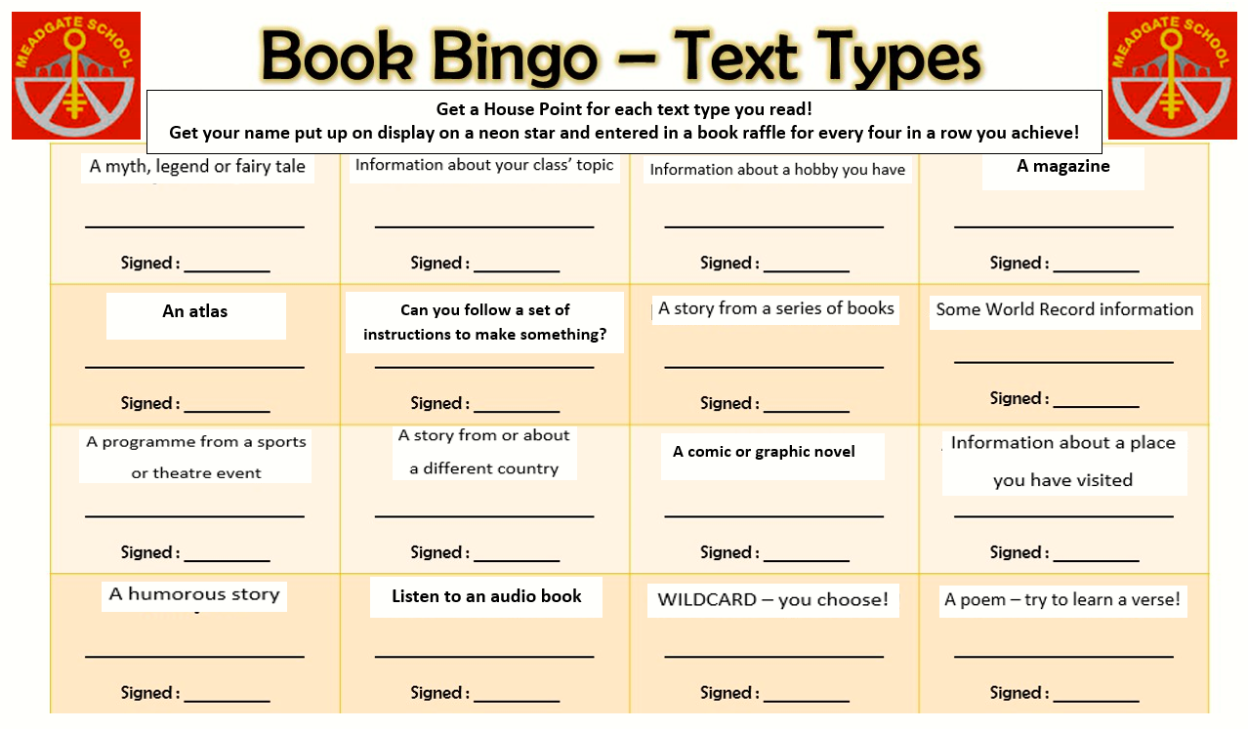

Slide 6

Autumn 1 Homework Project - Kite Research
Find out about a kite festival – there are lots to choose from! You could watch a kite festival video or read some information on the internet. Here is a good website to start Kite Flying Around the World: Festivals, Books, Crafts & More
Make some notes. Where in the world is the kite festival? When does it take place? What happens? Note down any facts which you think are interesting.
Write up your research. You can handwrite it, adding your own drawings or you could write it on a computer and add digital images. Think carefully about the presentation.
Hand it in! There will be house points rewarded for wonderful work!

Slide 7




How Parents Can Help
Your support at home makes an enormous difference to your child's progress and confidence. Here are practical ways to enhance their learning journey and strengthen the home-school partnership.
Read Together Regularly and Practice Spellings
Enjoy books together a few times each week. Discuss stories, characters, and predictions. I'll change reading books when I can see evidence of home reading in their diary. Children will be bringing home spellings to learn which are matched to their ability
Practise Times Tables
Make maths fun with games, songs, and apps. I'll be sending home specific tables to focus on each half-term, along with resources and suggestions for practice.
Encourage Independence
Allow your child to make mistakes and learn from them. Support their problem-solving efforts rather than immediately providing answers as this gradually builds resilience and confidence. Encourage them to talk to me if they have a problem.
Communicate with us
Please share concerns early, celebrate successes, and maintain open dialogue. We are here to support your child's individual needs and celebrate their achievements together. One of us is usually available after school. If there are any urgent messages before school, please contact the school office staff who pass these on to me.

Slide 8


Key Dates & Contact
Important Dates
Term dates and holidays: Please check the school website for updated calendar
Harvest Festival: Thursday 1st October
INSET Day: Friday 2nd October
Parents consultation evenings: 3rd, 4th, 5th November
If your child is on the SEND support register, their provision map will be reviewed by the end of November.
Thank you for your continued support.
Together, we'll make Year 3 a fantastic learning adventure for your child!
Contact Information
Class Teacher: Ms Kay Meager & Ms Christina Pateman
Email: admin@meadgate.essex.sch.uk
Best contact times: Before 8:45am (office staff)
or after 3:15pm (class teacher)
For urgent matters, please contact the school office directly.

