Slide 1
Phonics at
Meadgate Primary School
Parent information
14th October 2025
Notes:
Into self

Slide 2
What are we going to cover?
What is phonics?
What is Essential Letters and Sounds?
How we teach phonics
Getting children ready to read
Supporting your child with reading at home
Pronouncing pure sounds
Using the letter formations and spelling sequence to support writing at home.

Slide 3
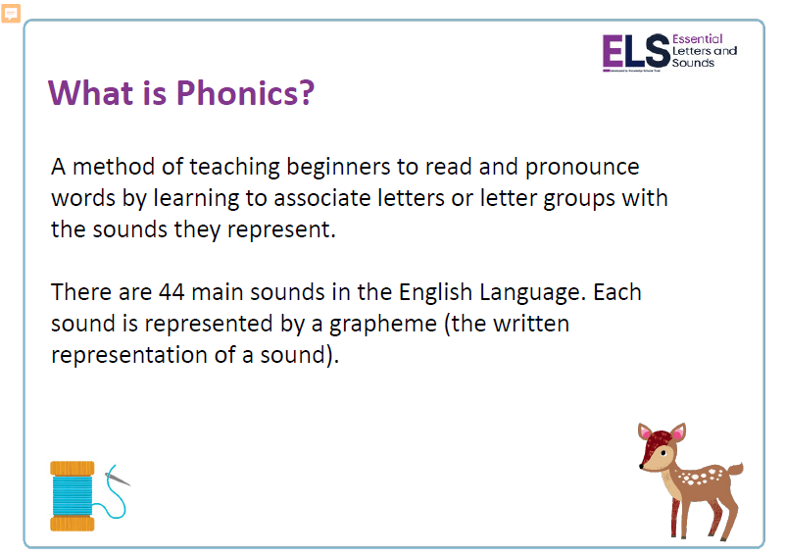
s

Slide 4
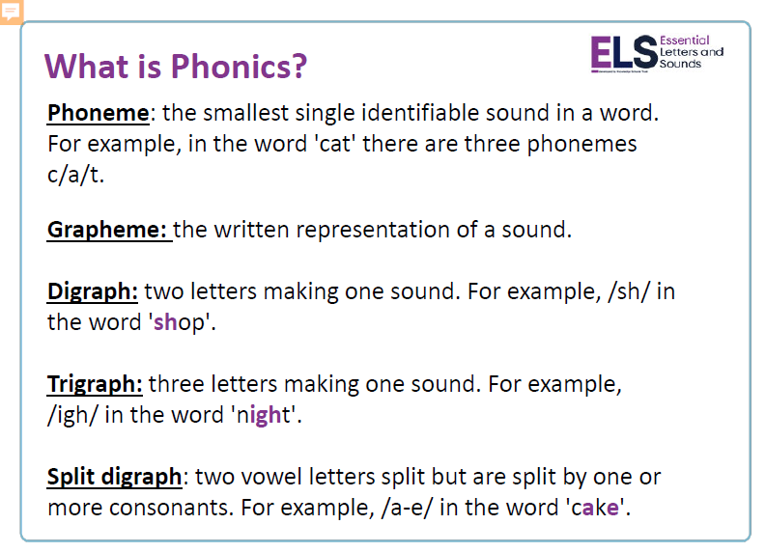

Slide 5

What is ELS?
Essential Letters and Sounds (ELS) is our chosen phonics programme. It teaches children to read by identify the phonemes within words and using these to read words.
Children experience the joy of books and language whilst rapidly acquiring the skills they need to become fluent independent readers and writers.

Slide 6
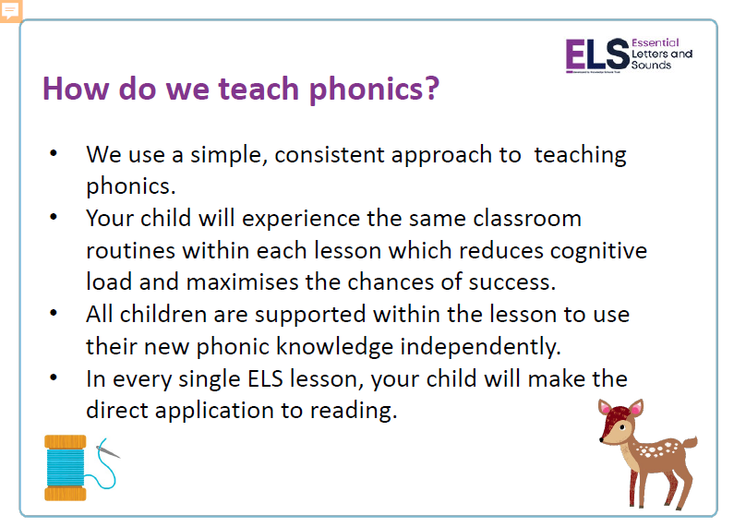

Slide 7
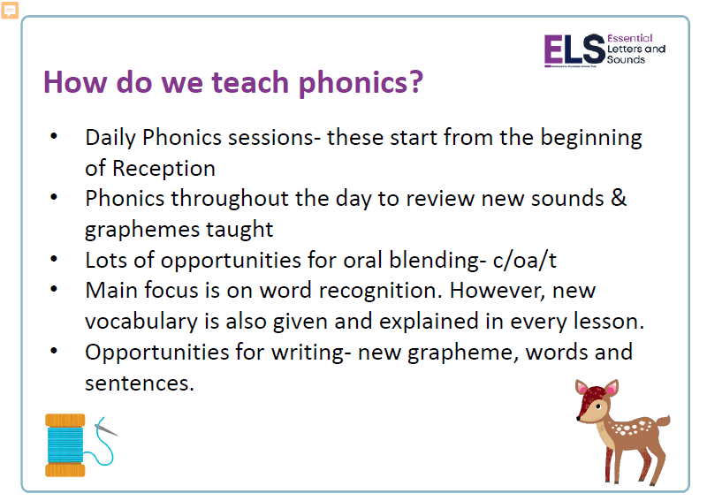

Slide 8
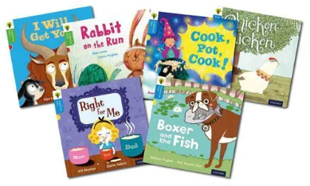
Your child will bring a book home every Friday. It will have a colour sticker on it with a letter a on.
These books are decodable. This means your child has been taught all the sounds (phonemes) and ways of writing them (graphemes) that are in the book. There will be a mixture of the previous weeks’ learning and new learning taught Monday to Thursday of that week.
It is for your child to read to YOU! They will need to try and read it 4 times between the Friday it is given out and the following Friday when a new book will be given.

Slide 9

Your child will also bring a book home every Friday. It will have a colour sticker on it with a letter b on.
These books are NOT fully decodable. This means your child will not know all the sounds and graphemes but they will enjoy talking about the pictures and what is happening in the story. They may recognise some words.
It is for you to share with your child.

Slide 10
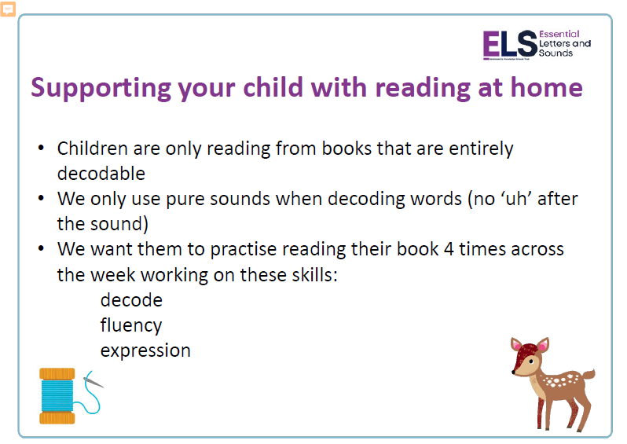
Listen to your child read and share books and text with them.
Look on the class web pages for videos showing you how to pronounce the sounds.

Slide 11
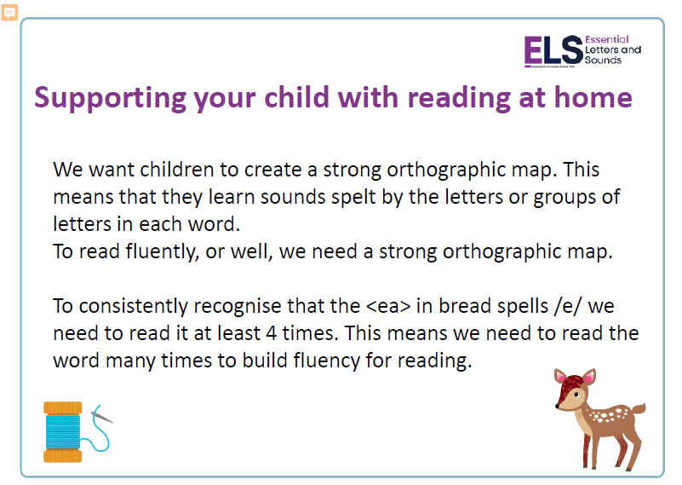
Reading fluency is important because it connects sounding out words with understanding them.
When reading becomes smooth and natural, students don’t have to focus on each word and can instead concentrate on what the text means.
This helps them do better in school and enjoy reading more.

Slide 12

Only 1 in 3 children are read a bedtime story at night.
Reading a bedtime story every night to your child improves their life outcomes.
If your child sees themselves as a ‘good reader’ when they leave primary school, they are more likely to earn a higher salary in their 40s.

Slide 13
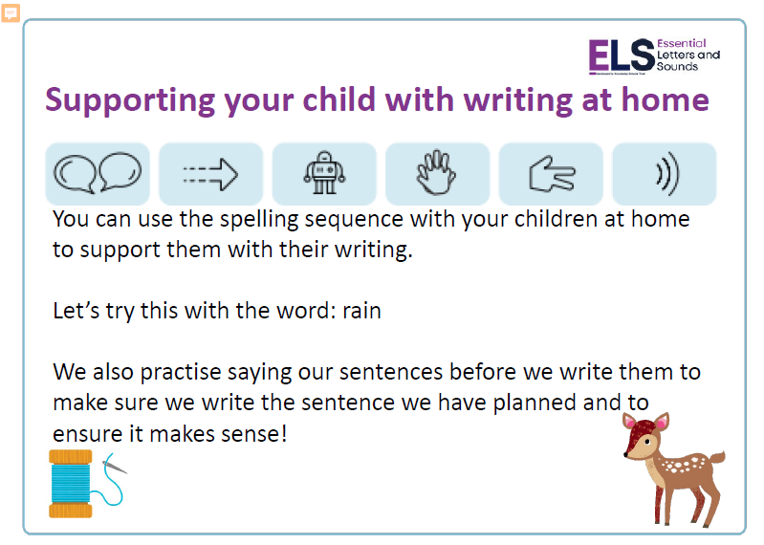

Slide 14
Any questions?
We cannot emphasise how important it is for home and school to work as a team – together we will help your child to acquire their early reading behaviours and skills.
Our aim is for your child to foster a love of books and to make progress with their reading so they feel successful and become confident, independent readers over time. Whenever you hear your child read or snuggle up for a story together you are giving them the tools for a life-long love of literature.
THANK YOU

