Slide 1
Years R,1 &2
Curriculum and Coffee
Wednesday 27th March 2024

Slide 2


Reading
Daily phonics and reading lessons yrs.' R, 1 & 2
We teach how to decode

Slide 3


Reading

Slide 4
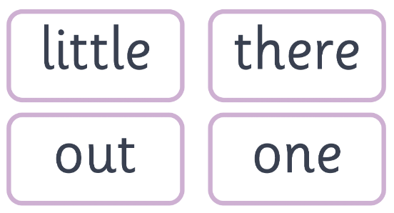
Reading
We also teach the children Harder to Read and Spell words.

Slide 5
Split digraph
2 letters that make one sound but are not together.
a-e e-e i-e o-e u-e
Hope
Pine
Cape

Slide 6

Reading at Home
Children take home an ‘a’ book and a ‘b’ book.
‘a’ is a decodable book with the sounds learnt to date
‘b’ books are for you to enjoy together.

Slide 7
Reading at home
Books are kept for a week for accuracy and fluency
It’s also important to focus on understanding the text
And expression when reading.
In years R and 1, they have 1:1 reading. Year 2 have small group and whole class reading

Slide 8

Spelling
Say it
Stretch it
Robot arms
Blending hands
Count the sounds
Say the word

Slide 9
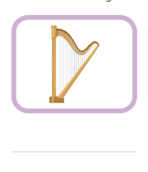
Spelling

Slide 10
Spelling Patterns
In year 2, they focus on spelling patterns
We send home ‘Super Spellers’ sheets from Summer term, in yr R.

Slide 11
Assessment
In year R and 1, we assess reading and phonics every half term.
At the end of year 1, the children will sit the statuary phonics screening assessment.
If the pass rate is not met, they will try again in year 2.
SAT’s are no longer compulsory for year 2

Slide 12
