Slide 1


Year One
Phonics Screening Check
Mrs Francis

Slide 2
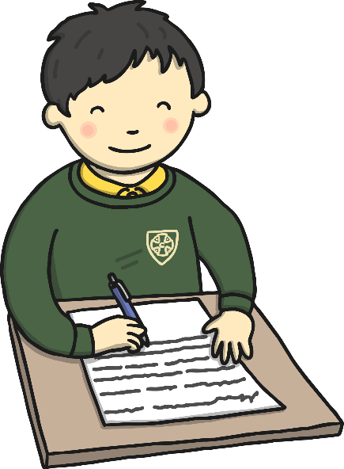
What is the Phonics Screening Check?
Children in Year 1 throughout the country will all be taking part in a phonics screening check during the same week in June (WB Monday 9th June 2025). Children in Year 2 will also take the check if they did not achieve the required result when in Year 1 or they have not taken the test before.
Headteachers will decide with class teachers whether it is appropriate for each of their pupils to take the phonics screening check. The phonics screening check is designed to confirm whether individual children have learnt phonic decoding and blending skills to an appropriate standard.

Slide 3

What Happens During the Test?
The test contains 40 words.
Each child will sit one-to-one and read each word aloud to their teacher.
The test will take approximately 10 minutes per child, although all children are different and will complete the check at their own pace.
The list of words the children read is a combination of 20 real words and 20 pseudo words (nonsense words).

Slide 4

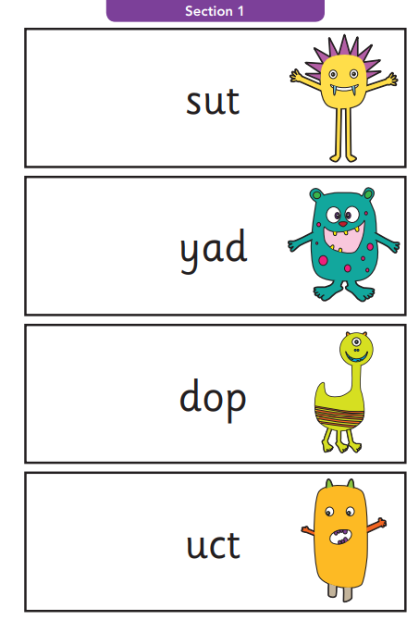
Pseudo Words (Nonsense Words)
Alien pictures help children understand that the word is not a real word.

Slide 5
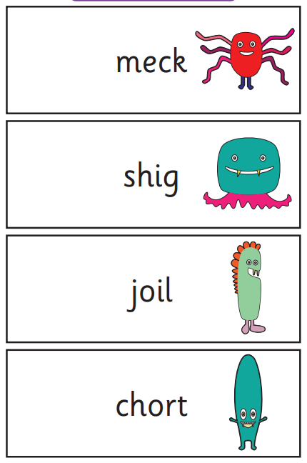
Pseudo Words (Nonsense Words)
Children can try as many times as they like to read the word.
e.g.
sh-igh-g shighg…
no..
sh-i-g shig

Slide 6
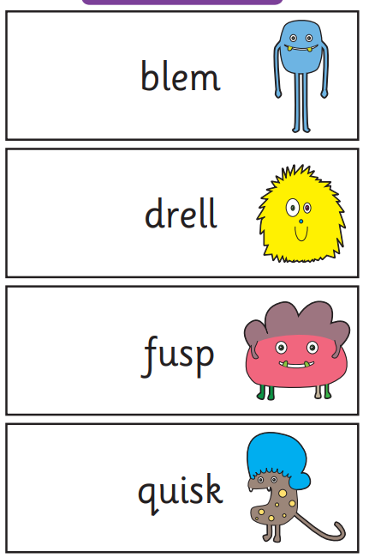
Pseudo Words (Nonsense Words)
The words can be read without decoding if a child prefers...

Slide 7
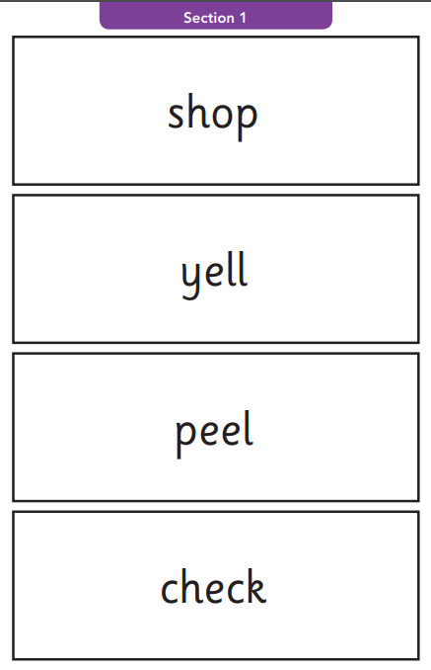
Real Words
…or they could decode the sounds instead.
But they MUST blend them together after to complete the word.
sh-o-p X
sh-o-p shop

Slide 8
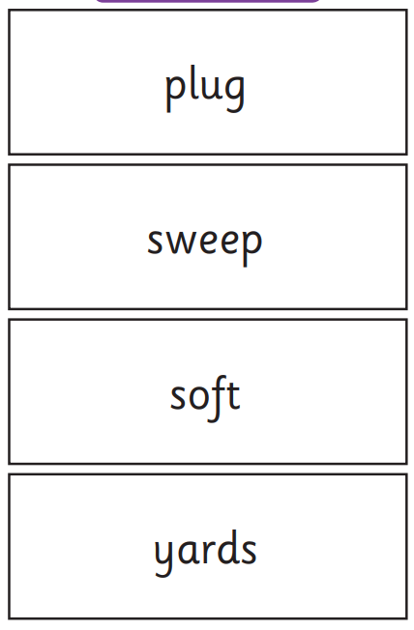
Real Words
It may be useful to spot any known digraphs or trigraphs before attempting the word.

Slide 9
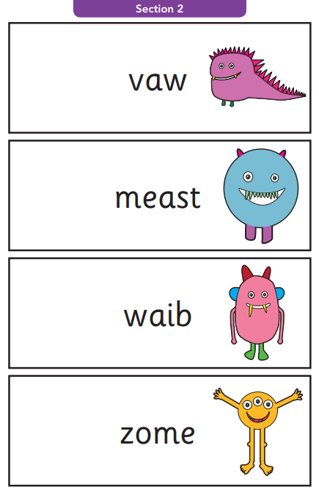
Pseudo Words (Nonsense Words)
Section 2 contains many phase 5 alternative pronunciations.

Slide 10
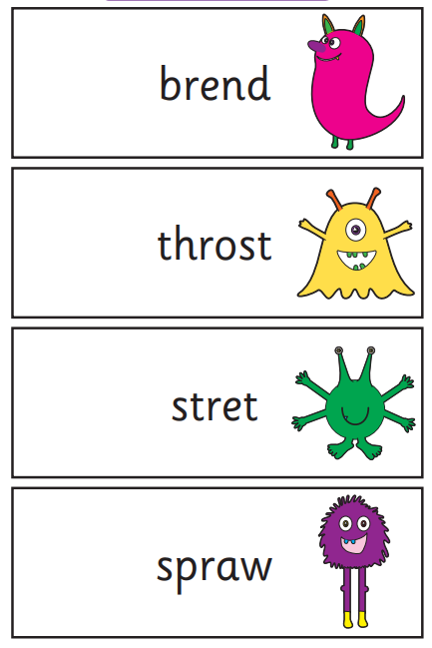
Pseudo Words (Nonsense Words)
There are also consonant blends which children of this age find tricky to enunciate, especially when their teeth are falling out!
A child’s typical speech patterns and accents are taken into consideration by the teacher during the screening for fairness.
e.g. r/w th/f

Slide 11
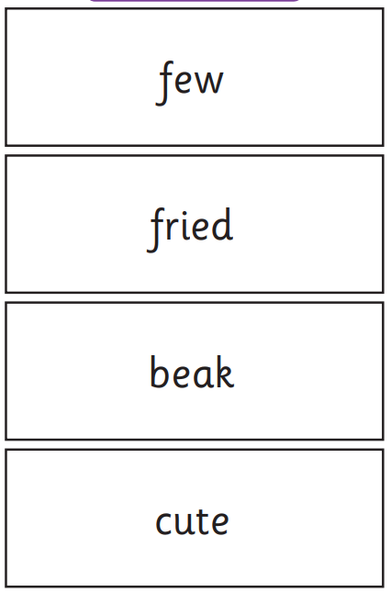
Real Words
Children are reminded when they are reading real words.
This helps them to try and ‘make’ the word sound like a word they know by changing the pronunciation slightly.
e.g. f-oo foo
Doesn’t sound right…
f-yoo few

Slide 12
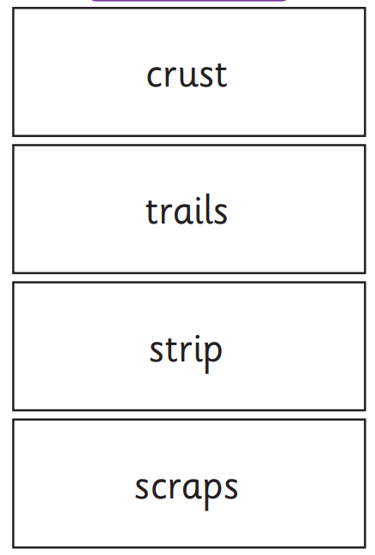
Real Words
There are times when a child doesn’t know the meaning of a real word and changes it to a different real word they know and they will not score a mark.
This is why talking to your child about the meaning of vocabulary is very important.
Previously, strip has been changed to stripe.
Scraps has been changed to scrapes.

Slide 13
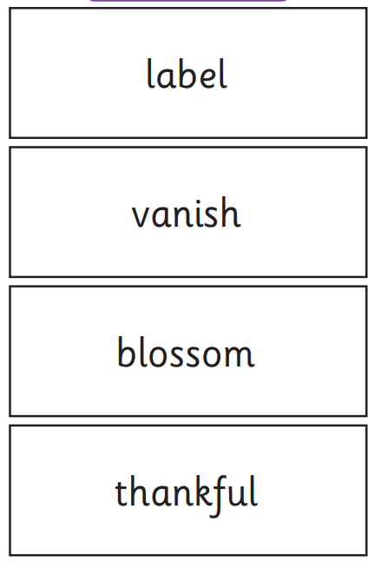
Real Words
The final page consists of 2 syllable, real words.
Children have been taught to ‘chunk’ up these words into syllables.
e.g.
v-a-n van i-sh ish vanish
Some children prefer to decode the word altogether which is also fine.

Slide 14


Reporting results
You will see your child’s results when you receive your child’s school report at the end of the summer term. You will find out if they met the threshold (32/40) and if not, additional phonics support will be offered to your child when they move into Year 2.
Results from the check will be used by schools to analyse their own performance and for Ofsted to use in inspections.

Slide 15
How Can I Help My Child at Home?
Read as much as possible to and with your child.
Practise reading the words in the packs to gain familiarity with the screening.
Encourage your child to spot any digraphs/trigraphs before attempting to read the word.
Blend the sounds by pointing to each one, e.g. /c/ in cat, /p/ in pat, /ng/ in sing, /ee/ in been. Next move your finger under the whole word as you say it.
Discuss the meaning of words if your child does not know what they have read.
Encourage and praise – get them to have a ‘good guess’.

Slide 16
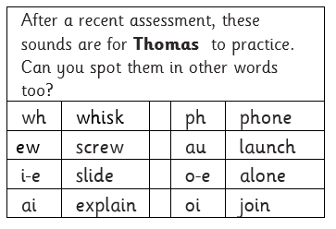
How Can I Help My Child at Home?
Use the phonics sound practise sheet in your child’s reading log which is based on a recent assessment.
It shows all the sounds that your child is not yet reading confidently.
Whenever you read, (hopefully daily) ask your child to read the sounds and tick them each time they are read correctly.

Slide 17
Thank you for your support.

