Slide 1
Mastering Number
EYFS and KS1 programme by the NCETM

Slide 2
What is Mastering Number?
Number sense and fluency
Number facts
Confidence
Developing learners confidence with number facts. Helping learners to think mathematically, flexibly and be able to problem solve.
Whole class teaching programme. 4 additional sessions of maths a week for around 15/20 minutes.

Slide 3
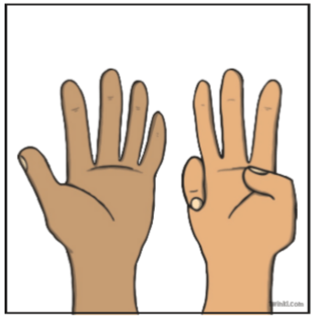
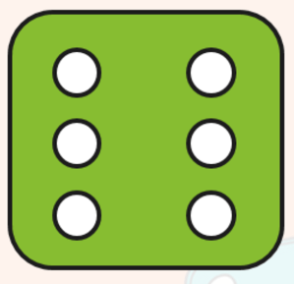
Number Sense
Subitising & Composition of numbers:
When you are able to look at a group of objects and realise how many there are without counting. This only works with small groups of numbers.
By linking an image or visual representation of a number to the number itself, we're able to forge a lasting connection between the two.

Slide 4
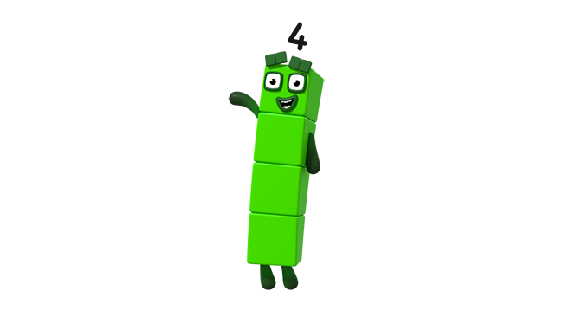
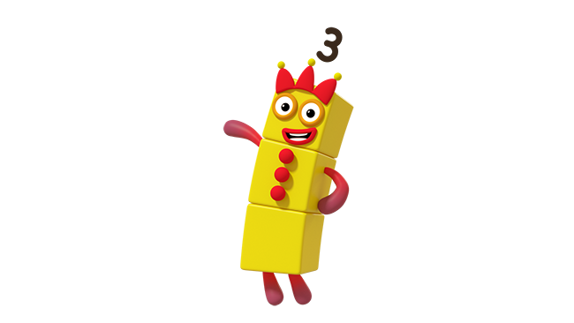
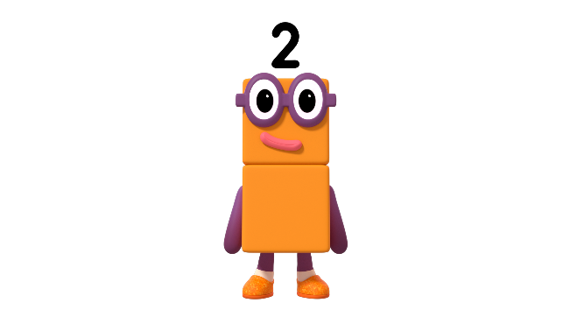
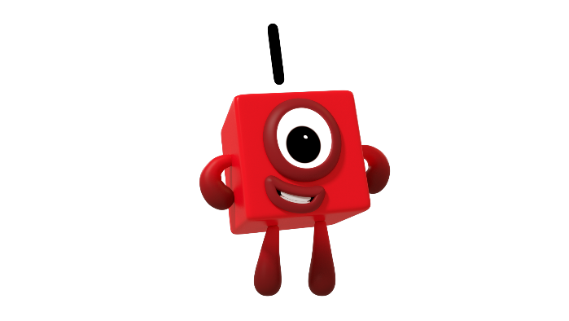
Play our spotty game! Look and say how many dots without counting!
Images © 2021 Alphablocks Ltd. All rights reserved. Mastering Number 2021/22 ncetm.org.uk

Slide 5
Mastering Number 2021/22 ncetm.org.uk

Slide 7
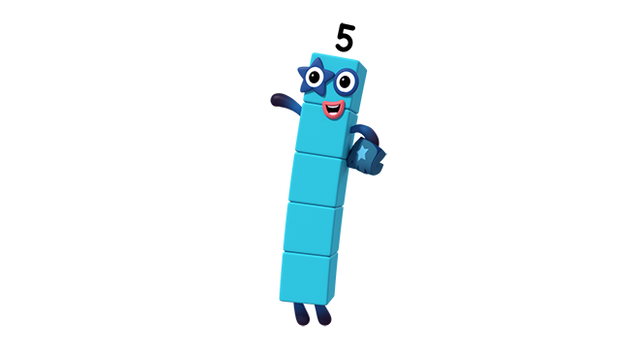
How did you know it was me?
Image © 2021 Alphablocks Ltd. All rights reserved. Mastering Number 2021/22 ncetm.org.uk

Slide 8
Mastering Number 2021/22 ncetm.org.uk

Slide 9
What’s the same and what’s different?
Image © 2021 Alphablocks Ltd. All rights reserved. Mastering Number 2021/22 ncetm.org.uk

Slide 10
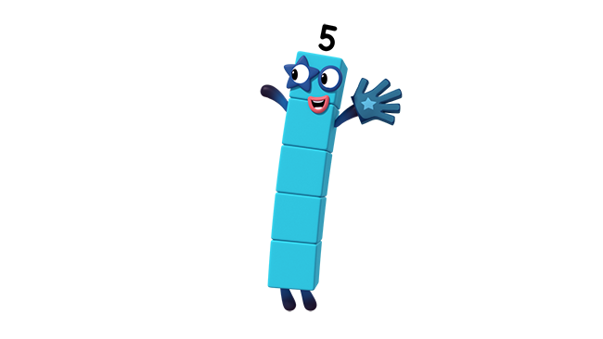
What do you notice this time?
Image © 2021 Alphablocks Ltd. All rights reserved. Mastering Number 2021/22 ncetm.org.uk

Slide 11
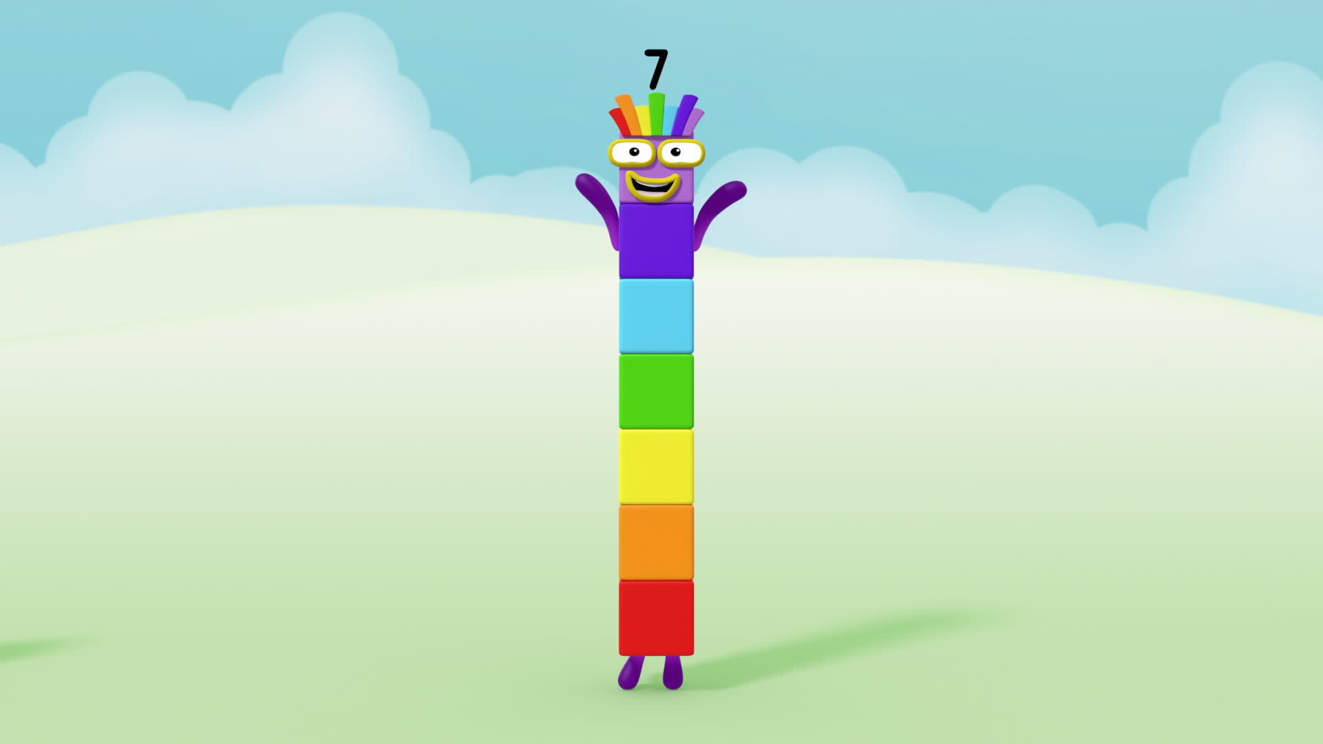

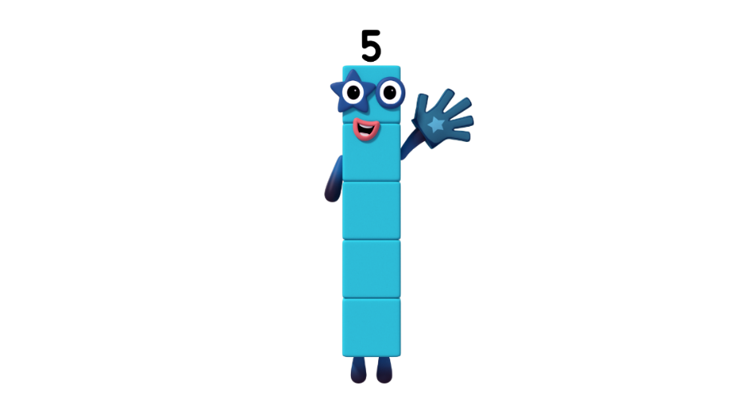
Where can you see the Five in me?
What can you see now?
Image © 2021 Alphablocks Ltd. All rights reserved. Mastering Number 2021/22 ncetm.org.uk

Slide 12
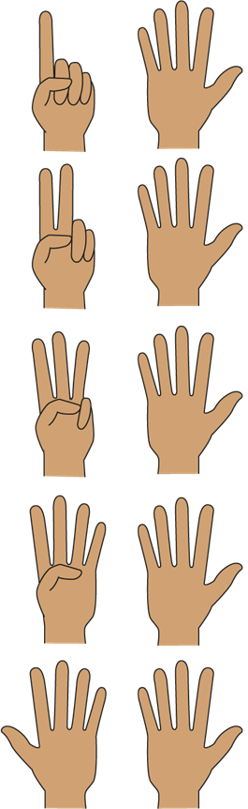
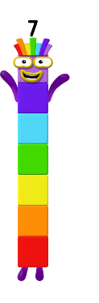
6 or 7?
_____ is made of 5 and _____ ;
5 and _____ make _____ .
Images © 2021 Alphablocks Ltd. All rights reserved. Mastering Number 2021/22 ncetm.org.uk

Slide 13
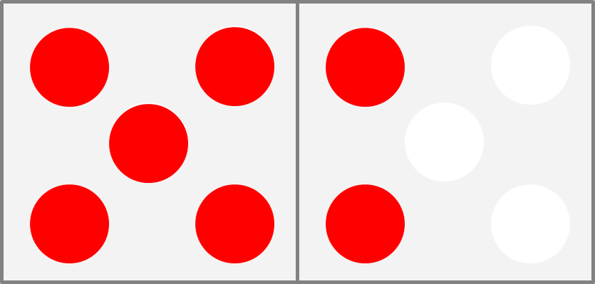
6 or 7?
_____ is made of 5 and _____ ;
5 and _____ make _____ .
Images © 2021 Alphablocks Ltd. All rights reserved. Mastering Number 2021/22 ncetm.org.uk

Slide 14
Mastering Number 2021/22 ncetm.org.uk

Slide 15
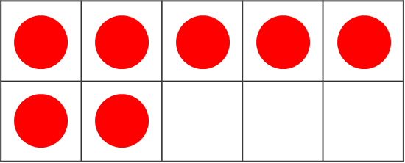
Same or different?
7
7
Mastering Number 2021/22 ncetm.org.uk

Slide 16
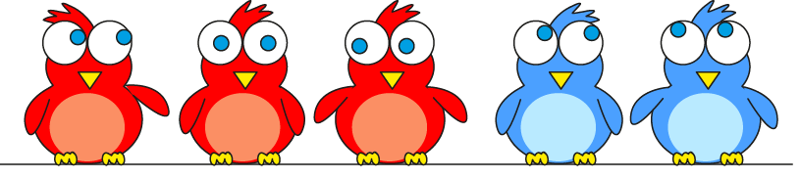
Make 7
5 needs _____ to make _____ .
Mastering Number 2021/22 ncetm.org.uk

Slide 17
Number Sense
Number facts & arithmetic:
The quick recall of number facts up to 10 is vital for fluency in maths later in school.
A systematic approach is crucial. The use good models and representations supports learners to quickly recall number facts. They will then be able to recall these facts much more quickly and accurately in the future. They then can become secure in knowing the number facts across 10 and up to 20.
Important that they become confident with number facts and that they no longer need to count on or back.

Slide 18
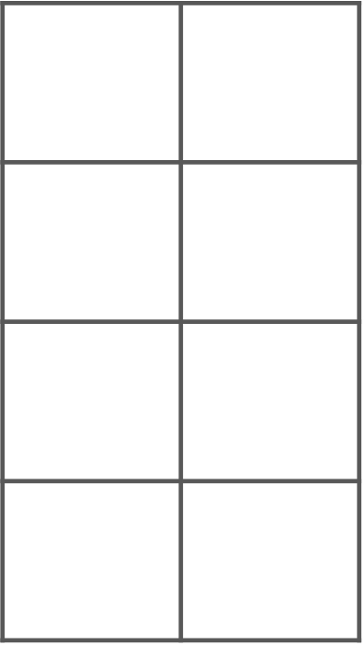
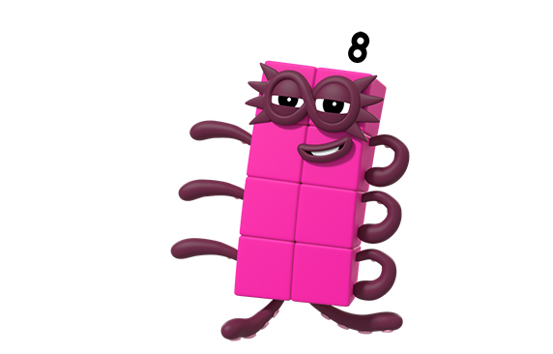
Use your 8-grid to find all the ways to make 8.
It’s my shape!
Image © 2021 Alphablocks Ltd. All rights reserved. Mastering Number 2021/22 ncetm.org.uk

Slide 19
8 is made of _____ and _____ ;
_____ and _____ make 8.
Mastering Number 2021/22 ncetm.org.uk

Slide 20
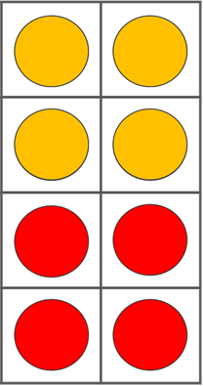
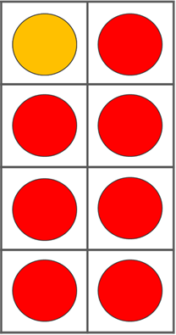
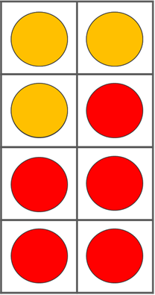
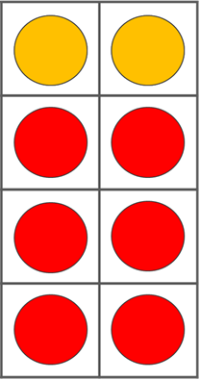
Sort the expressions
for 8:
Even + Even | Odd + Odd
4 + 4
7 + 1
6 + 2
1 + 7
2 + 6
5 + 3
3 + 5
Mastering Number 2021/22 ncetm.org.uk

Slide 21
Convince a friend each arrangement shows 8!
Mastering Number 2021/22 ncetm.org.uk

Slide 22
Practice task: fill in the missing numbers.
4 | + |  | = | 8
5 | + |  | = | 8
 | + | 2 | = | 8
 | + | 1 | = | 8
4
8 | = |  | + | 7
8 | = |  | + | 6
8 | = | 3 | +
8 | = | 4 | +
1
3
2
6
5
7
4
Mastering Number 2021/22 ncetm.org.uk

Slide 23
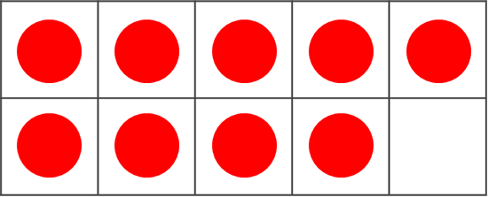
Let’s make 10!
_____ needs _____ to make 10.
Mastering Number 2021/22 ncetm.org.uk

Slide 24
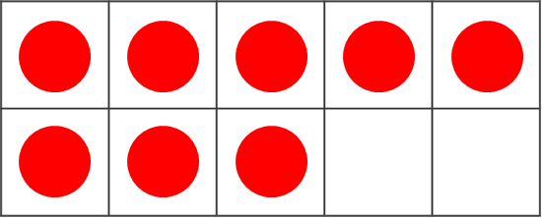
Let’s make 10!
_____ needs _____ to make 10.
Mastering Number 2021/22 ncetm.org.uk

Slide 25
Let’s make 10!
_____ needs _____ to make 10.
Mastering Number 2021/22 ncetm.org.uk

Slide 26

How many more birds need to sit on the BOTTOM ROW so there are 10 birds altogether?
Mastering Number 2021/22 ncetm.org.uk

Slide 27
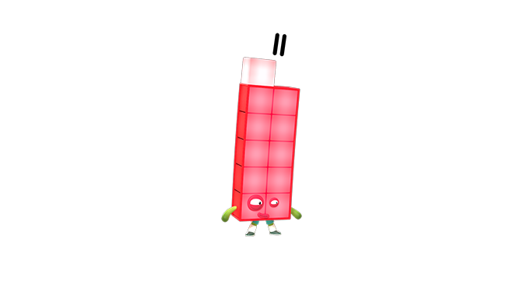
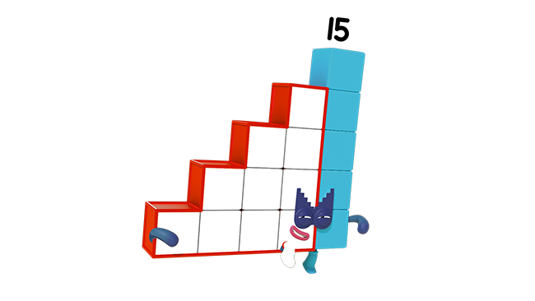
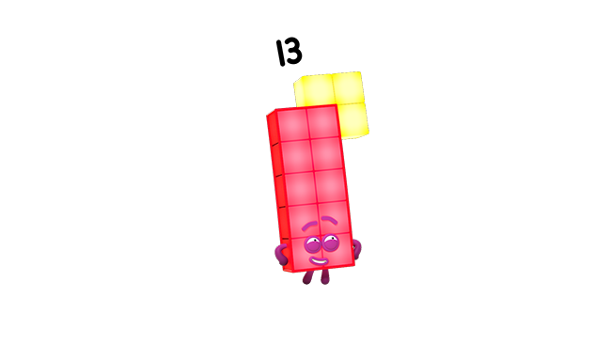
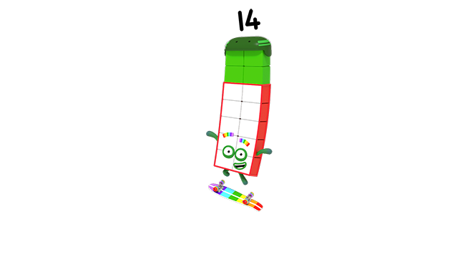
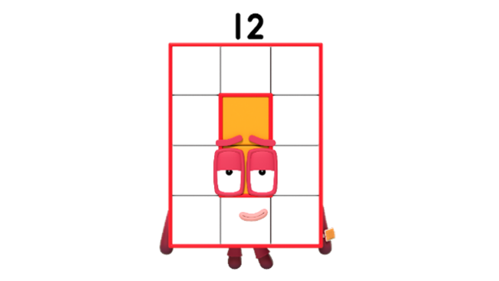
Can you see that 10 is a part of me and my friends?
Images © 2021 Alphablocks Ltd. All rights reserved. Mastering Number 2021/22 ncetm.org.uk

Slide 28
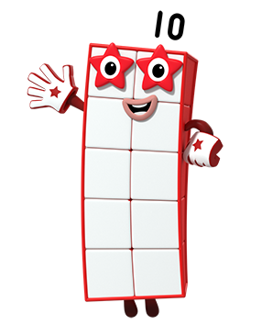
Use your rekenrek to help you say what 10 needs to make other numbers!
Image © 2021 Alphablocks Ltd. All rights reserved. Mastering Number 2021/22 ncetm.org.uk

Slide 29
Make each number using all the beads on the top row
10 needs _____ to make _____ ;
_____ is made of 10 and _____ .
Image © 2021 Alphablocks Ltd. All rights reserved. Mastering Number 2021/22 ncetm.org.uk

Slide 30
10 needs _____ to make _____ ;
_____ is made of 10 and _____ .
Image © 2021 Alphablocks Ltd. All rights reserved. Mastering Number 2021/22 ncetm.org.uk

Slide 31
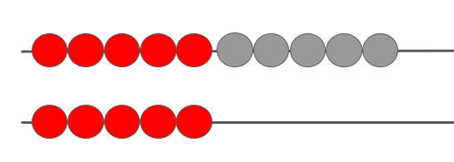
How can we ‘see’ 10 and 5 in 15?
10
5
10
5
Mastering Number 2021/22 ncetm.org.uk

Slide 32
15
Fifteen
_____ is made of 10 and _____ ;
10 and _____ make _____ .
Mastering Number 2021/22 ncetm.org.uk

Slide 33
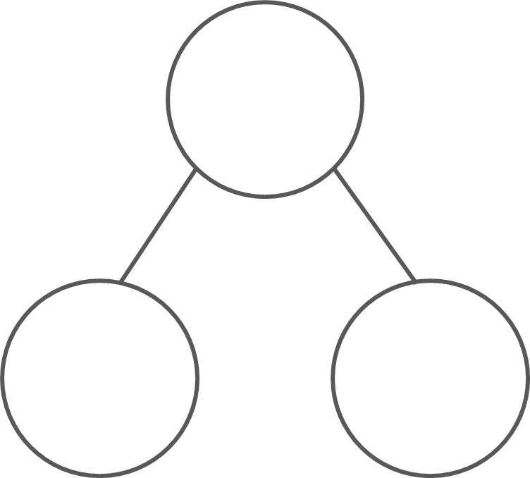
How can you represent this number in the part–part–whole diagram?
14
10
4
_____ can split into _____ and _____ ;
_____ and _____ combine to make _____ .
Mastering Number 2021/22 ncetm.org.uk

Slide 34
Find the missing part or the missing whole
14
16
12
10
4
10
6
2
10
13
17
15
3
10
10
7
5
10
_____ can split into _____ and _____ ;
_____ and _____ combine to make _____ .
Mastering Number 2021/22 ncetm.org.uk

Slide 35
How many beads are hidden? How do you know?
_____ needs _____ to make 10;
so, _____ needs _____ to make 20.
Version 2 (2022)
Mastering Number 2021/22 ncetm.org.uk

Slide 36
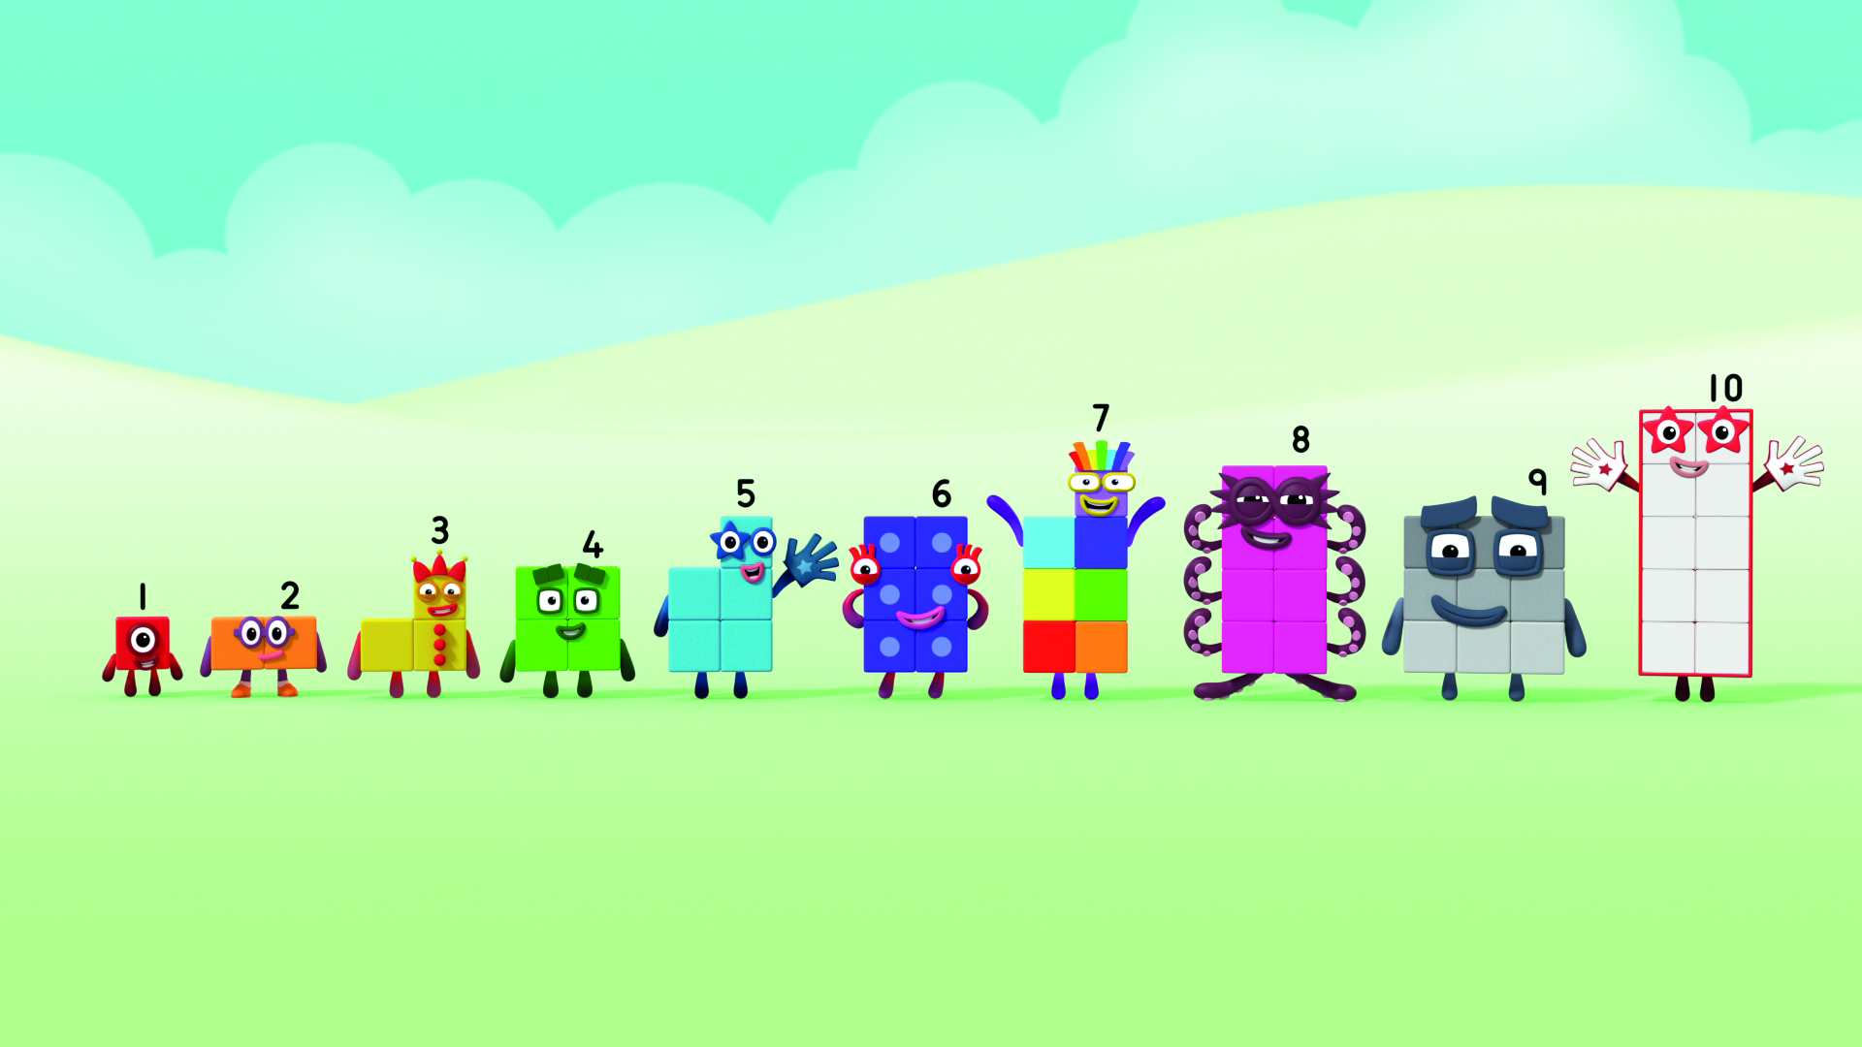
All the EVEN numbers are made of 2s! We have flat tops. Can you spot us?
What can you remember about EVEN numbers?
Image © 2021 Alphablocks Ltd. All rights reserved. Mastering Number 2021/22 ncetm.org.uk

Slide 37
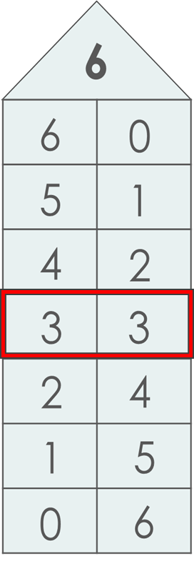
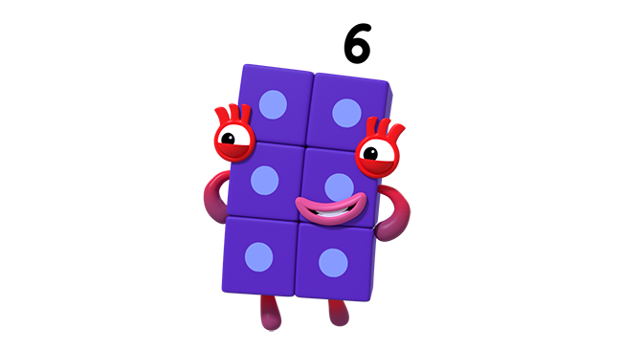
I can split into 2 equal parts as well! What will the parts be?
_____ can split into _____ and _____ ;
_____ and _____ combine to make _____ .
Image © 2021 Alphablocks Ltd. All rights reserved. Mastering Number 2021/22 ncetm.org.uk

Slide 38
How can you DESCRIBE what you see here?
Double _____ is _____ ;
half of _____ is _____ .
Mastering Number 2021/22 ncetm.org.uk

Slide 39
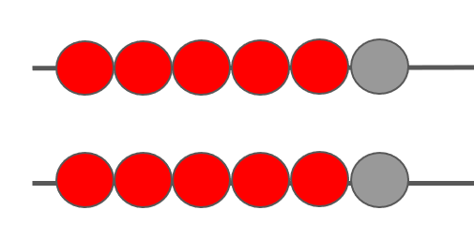
12
Mastering Number 2021/22 ncetm.org.uk

Slide 40
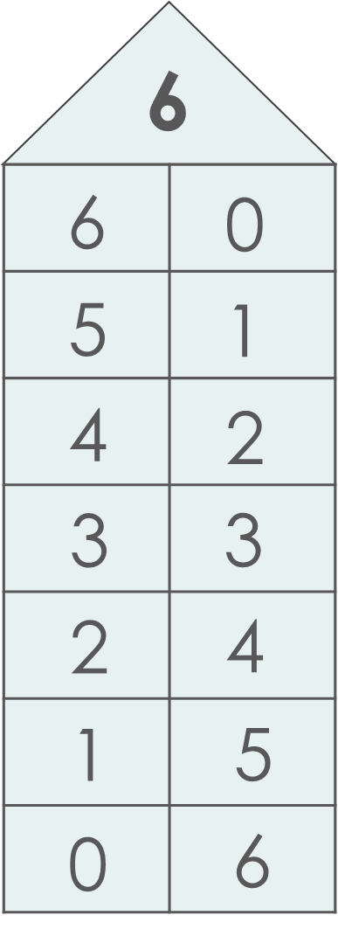
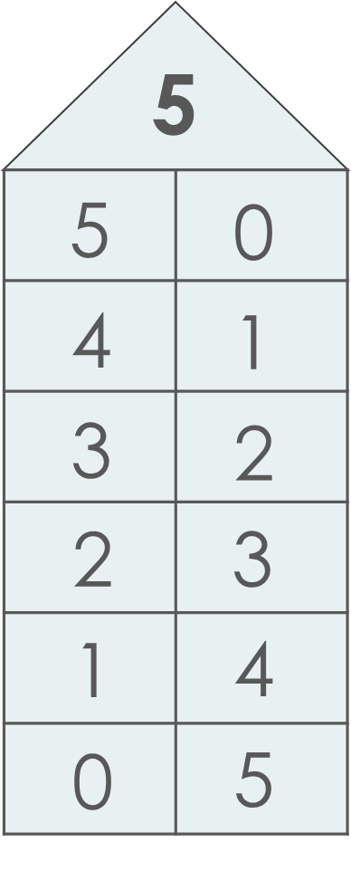
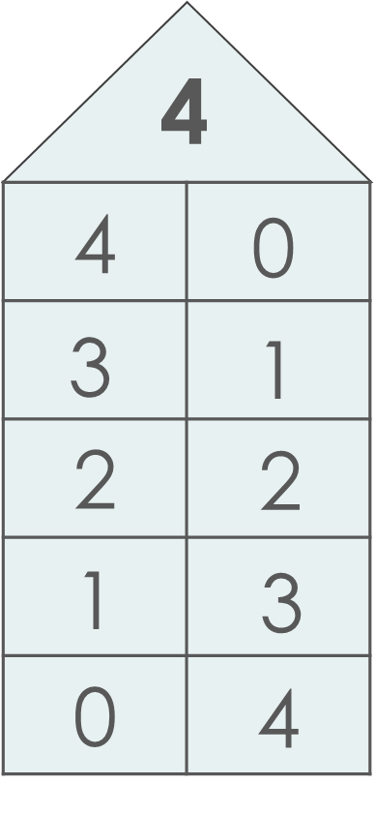
Did you notice this? What do these pairs of numbers look like on a rekenrek?
Image © 2021 Alphablocks Ltd. All rights reserved. Mastering Number 2021/22 ncetm.org.uk

Slide 41
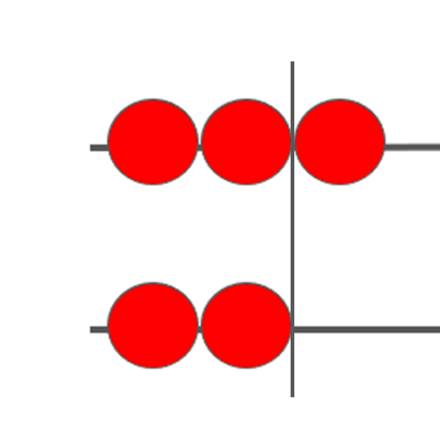
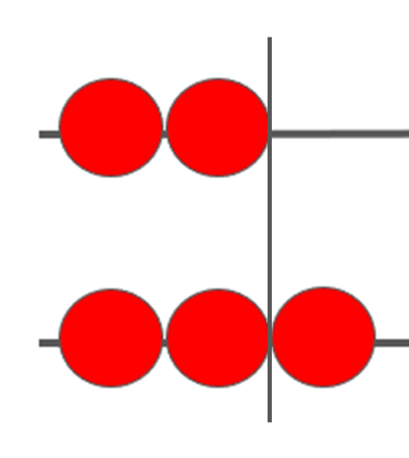
Can you make me and some other ‘near doubles’ on your rekenrek? Can you think of different ways to do it?
You can call me a ‘near double’!
Image © 2021 Alphablocks Ltd. All rights reserved. Mastering Number 2021/22 ncetm.org.uk

Slide 42
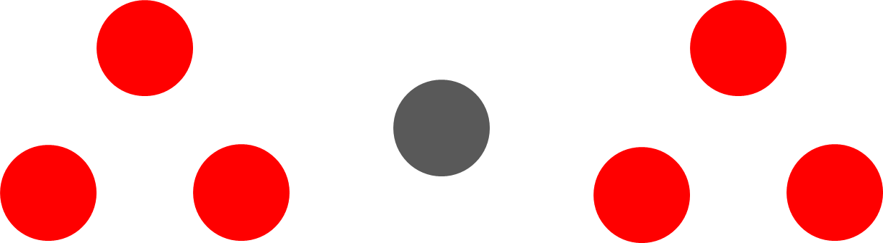
Double _____ is _____ ; add 1 is _____ .
Mastering Number 2021/22 ncetm.org.uk

Slide 43

4 | + | 5
5 | + | 4
Mastering Number 2021/22 ncetm.org.uk

Slide 44
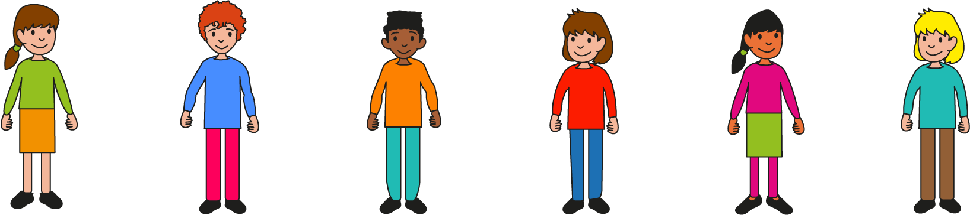
I can make a ‘near double’ by making a double and adding 1.
Double _____ is _____ ; add 1 is _____ .
Mastering Number 2021/22 ncetm.org.uk

Slide 45
I can make a ‘near double’ by making a double and taking 1.
Double _____ is _____ ; take 1 is _____ .
Mastering Number 2021/22 ncetm.org.uk

Slide 46
Match the expressions to the correct sum
7 + 8
6 + 7
8 + 9
5 + 6
11
13
15
17
Double _____ is _____ ; add 1 is _____ .
Mastering Number 2021/22 ncetm.org.uk

Slide 47
How can you use the double to find the sums?
7 | + | 7 | = | 14
15
15
7 | + | 8 | =
8 | + | 7 | =
13
13
7 | + | 6 | =
6 | + | 7 | =
Mastering Number 2021/22 ncetm.org.uk

Slide 48
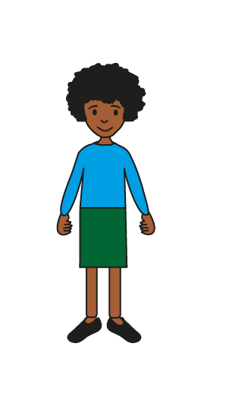
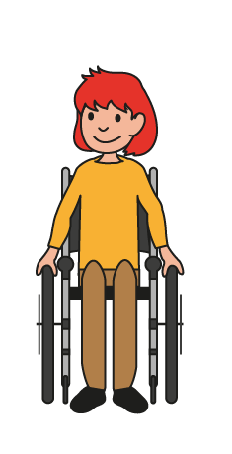
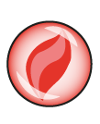

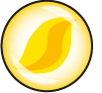
Use number facts you know – don’t count!
Can you quickly work out how many marbles we drop? Is it 10 or fewer than 10?
Mastering Number 2021/22 ncetm.org.uk

Slide 49
Mastering Number 2021/22 ncetm.org.uk

Slide 50
Mastering Number 2021/22 ncetm.org.uk

Slide 51
Number at Home
Play subitising games – lots online, use objects at home, pictures, Numberblocks, Numicon
Look at different ways numbers to 10, then 20, can be composed (visual representations)
Practise number facts – start off with numbers to 5 and only progress when your child is confident and fluent.
Magnificent Maths homework sheets
Topmarks – app/online – fun maths games e.g. Hit the Button, Ladybird Spots

