Slide 1
UKS2 Year 5 and 6
Ms Pateman
KS2 Lead

Slide 2
SATs – Standard Assessment Tests
These are carried out in May of Year 6. They are designed to test children on everything they have learned in KS2 and are marked externally.
The children's exercise books are then moderated in June of Year 6 to check teacher assessment for writing.
Teacher assessments for reading, writing, maths and science are submitted to the DofE by the end of June in Year 6.
SATs results come in early July and are checked. Parents and students receive these in the written school report mid-July.

Slide 3
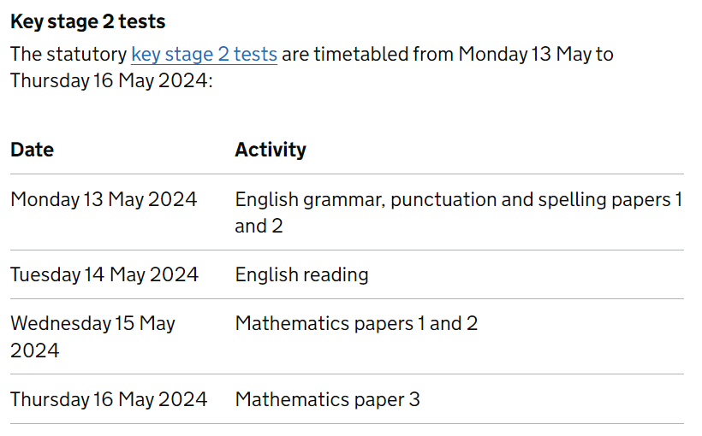
Current Year 6

Slide 4
Current Year 5

Slide 5
What are Scaled Scores?
In July of Year 6 each pupil will receive:
A raw score (number of marks awarded).
A scaled score in each tested subject.
Confirmation of whether or not they attained the national standard.
100 represents the ‘national standard’ or Working At the expected standard. Each pupil’s raw test score will therefore be converted into a score on the scale, either at, above or below 100. We start using this system in Spring of Year 3 on reading tests and track children through KS2.

Slide 6
Scaled Scores continued
A child who achieves the ‘national standard’ (a score of 100) will be judged to have demonstrated sufficient knowledge in the areas assessed by the tests. These children will be Working At.
A child who achieves a score of 110 or more will be judged to have demonstrated Greater Depth. A child who achieves a score below 100 will be judged to be Working Towards the expected level.

Slide 7
The Reading Test
The Reading Test consists of a single test paper with three unrelated reading texts. Children are given 60 minutes in total, which includes reading the texts and answering the questions. A total of 50 marks are available.
Questions are designed to assess the comprehension and understanding of a child’s reading and vocabulary at a very high level.
Some questions are multiple choice or selected response but most require an extended response or in-depth explanation.

Slide 8
Sample Short Answer Question
Find and copy one word meaning relatives from long ago?
ancestors

Slide 9
Sample Short Answer Questions
Find and copy one word that suggests that the summer afternoon was quiet?​
hush​

Slide 10
Sample Multiple Choice Question
Which word most closely matches the meaning of the word rival?
equal
neighbouring
important
competing​

Slide 11
Sample Longer Answer Question
What does the word spat suggest about how the island of Mauritius was formed?
Answer needs to include a reference to forcefulness or suddenness​

Slide 12
SATs Longer Answer Reading Questions
What does rehabilitate the image of the dodo mean?
Answer needs to include a reference to
restoring a painting, repairing a model of, reviewing accounts of the dodo.

Slide 13
Reading in School
In school, your child will be taught a range of reading comprehension skills, mostly through reading novels appropriate to their age. We do this through whole-class reading.
Reading is tested in UKS2 through a written comprehension test. Year 5 and 6 pupils need to be exposed to very high-level vocabulary to understand the texts and to be able to understand the questions.

Slide 14
Homework: Reading Challenges & Book Bingo
Please make sure your children are reading regularly at home for at least 10-20 minutes three or four times a week.
Please encourage your children to record their reading in their reading record book – or you could if you have heard them read. Every Monday I give house points to children who have obviously read at home.

Slide 15
The Grammar, Punctuation and Spelling SATs Tests
A spelling test is administered containing 20 words, lasting approximately 20 minutes.
A separate test is given on punctuation, vocabulary and grammar. This test lasts for 45 minutes and requires short answer questions, including some multiple choice.
Marks for these two tests are added together to give a total for spelling, punctuation and grammar.

Slide 16
Sample Grammar, Punctuation and Spelling SATs Questions

Slide 17
Sample Grammar, Punctuation and Spelling SATs Questions

Slide 18
Grammar, Punctuation and Spelling in School
All skills are taught through writing and reading units in class. Each writing and reading unit has specific skills which are explicitly taught within the context of that unit and then repeated and reused in subsequent units of work.
We assess your child's understanding and use of these skills through their own writing. This assessment is ongoing.
In UKS2, we revise skills from LKS2 as well as teaching higher-order UKS2 skills.

Slide 19
Homework
Children in Years 5 and 6 have spelling lists that they practise in school but also take home to learn too. These are personal to their spelling ability.
Please support your child in learning their spellings and make sure they let us know when they are ready for a test and can move onto something new.
When they complete a piece of written homework, help them check spellings and punctuation. Encourage them to use their best handwriting skills too.

Slide 20
Mathematics
Children will sit three tests: paper 1, paper 2 and paper 3.
Paper 1 is an arithmetic test lasting for 30 minutes, covering calculation methods for all operations, including use of fractions, percentages and decimals.
Papers 2 and 3 cover ‘problem solving and reasoning’, each lasting for 40 minutes. Pupils will still require calculation skills but will need to answer questions in context and decide what is required to find a solution.

Slide 21
SATs Questions

Slide 22
SATs Questions

Slide 23
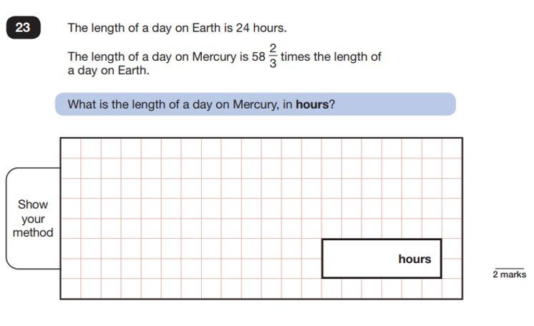
SATs Questions

Slide 24
Mathematics at Home
Make sure your children know all multiplication facts up to 12 x 12 and associated division facts.​ If they don't, they will need a lot of support to understand concepts such as: fractions, ratio and proportion, probability and will be very slow to calculate any multiplication or division questions. T T Rock Stars is very popular in school and can be used at home too.
Look over test papers that come home – I often list a few questions that I think your child could have another go at.​

Slide 25
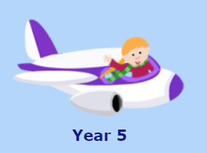
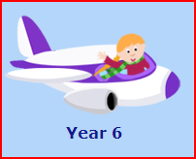
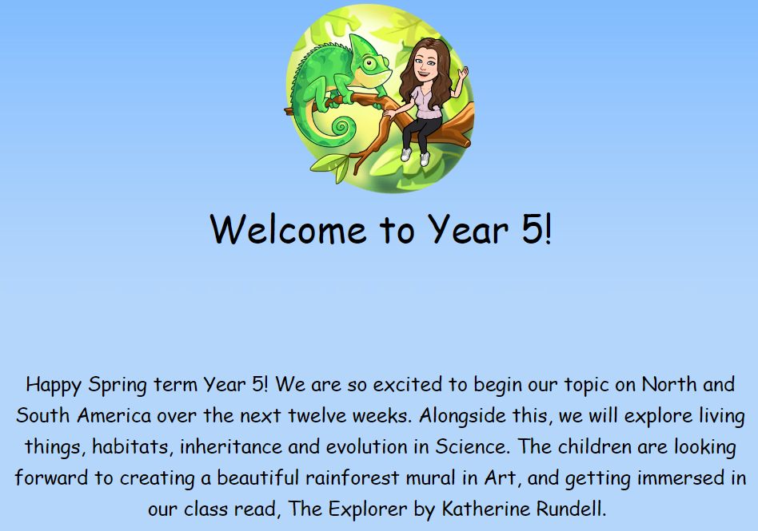
Meadgate Website – Year 5 and 6 Pages
Meadgate website Click on
and select class pages
Then click on Year 5 or Year 6
And you will find your
child's class.
There are links to our curriculum and other websites that can help your child with their learning.

Slide 26
We encourage Year 5 and 6 children to be:
good communicators
enthusiastic learners
creative thinkers
confident
caring and helpful to others
independent
polite with good manners
able to persevere
not afraid to make mistakes
willing to take risks.

Slide 27
The Prefect System
We invite pupils in Year 6 to become prefects when they:
are showing these qualities
have proved themselves to be an excellent example to others - both in the classroom and around the school
and are working their socks off in class...quietly!

Slide 28
The Prefects’ Role
to act as a role model for pupils and promote the ethos and values of Meadgate Primary School
to carry out prefect duties punctually
to assist staff and support children to follow the school rules at all times during the day.

