Slide 1
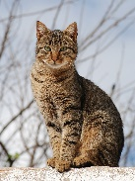
Year 6 SUPER CHALLENGE! This is Kim’s Game
To play this you will need a family team so go and find as many people who can join in as possible!
The next slide will stay on the screen for 2 minutes.
Take a good look. Remember each of the items. As you know, I have a terrible visual memory. If you are like me, here’s a top tip: instead of trying to memorise a each picture like a photo, make up a story using the objects.
E.g. A cat walked into the forest and had a cup of tea.
After the 2 minutes the slide will change and you will have to figure out which object is missing. The secret to success here Year 6 is TEAMWORK! Good luck

Slide 2
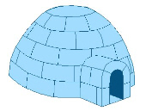

Slide 3
There were 20 items on the first slide – as a team write down the ones you can remember.

Slide 4
Which item is missing on the next slide?

Slide 6
Which item is missing on the next slide?

Slide 8
Which item is missing on the next slide?

Slide 10
Which item is missing on the next slide?

Slide 12
Which item is missing on the next slide?

Slide 14
Answers:
Camera | Watch
Globe | Clock
Eiffel Tower | Pencil
Pen | Holly
Glasses | Apple
Igloo | Transmitter/Satellite
Scales | Cathedral/Castle/Church
Post card/Envelope | Light bulb
Cup and saucer | Ice-cream/Sundae
Grapes | Butterfly

Slide 15
Answers:
First missing item – Apple
Second missing item – Church/Cathedral
Third missing item – Envelope/Post card
Fourth missing item – Cup and Saucer
Fifth missing item - Butterfly

Slide 16
Congratulations if you got any right!
If you would like to you could message
me on the vle and tell me how you did!

