Slide 1

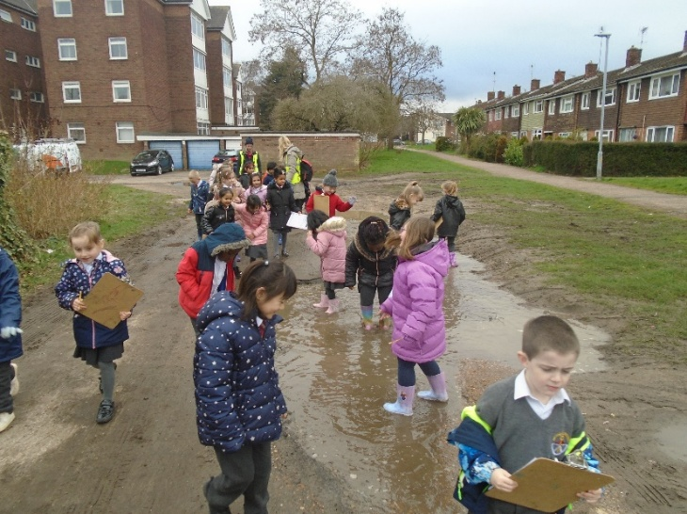
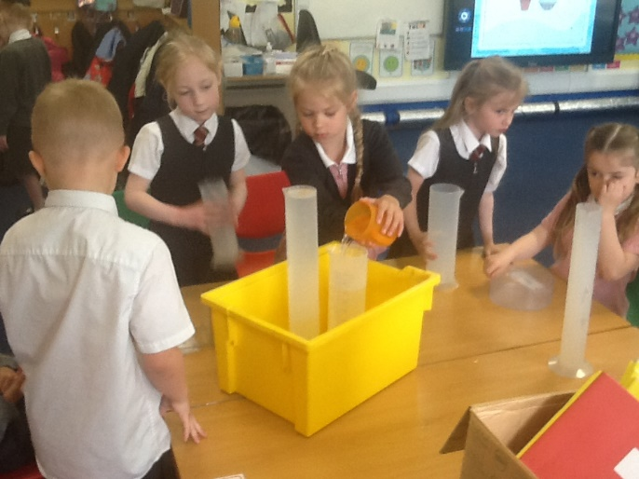
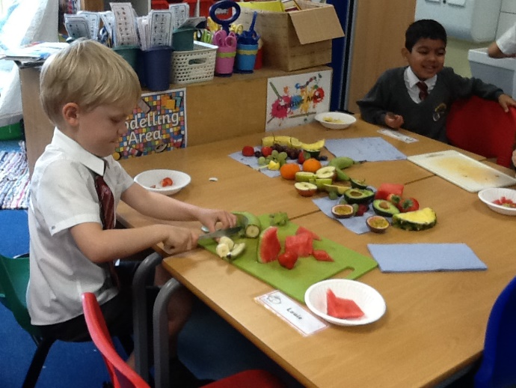
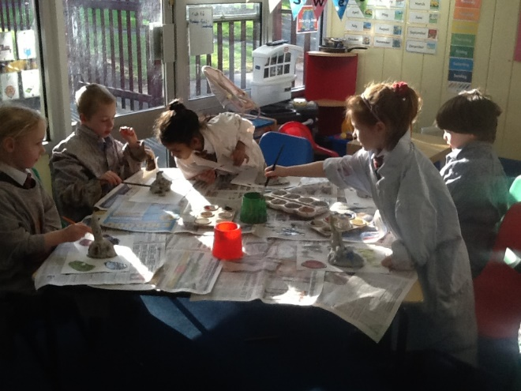
Welcome to Year 1
2026/2027

Slide 2

Meet the Team
Teachers:
Mon-Tues Mrs Francis Weds-Fri Mrs Leake
LSAs:
Miss Dennis and Mrs Morton
PPA Cover:
Thursday morning Mrs Davine
School Times:
Drop off: 8.35-8.50
Pick up: 3.15

Slide 3
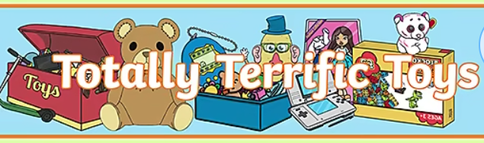


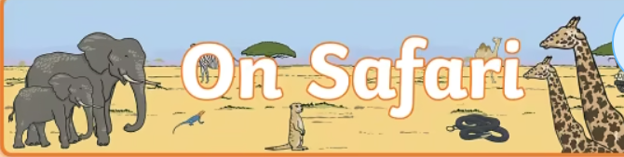
Topics
Autumn
Spring
Summer

Slide 4

Learning and Playing
Daily
Phonics/English
Maths
Other subjects
Science
Computing
History
Geography
Art
Design Technology
Music
RE
PSHE
2x PE lessons (Tues-indoor and Thurs-outdoor)
Swimming (Thurs-optional).
Notes:
There is an emphasis on phonics again this year as the children will have their phonics screen check in July.

Slide 5
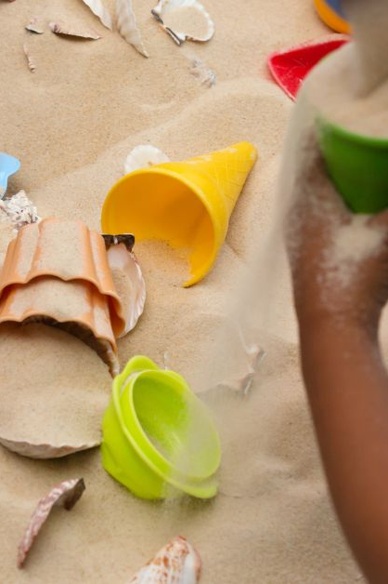
Continuous Provision
Continuous provision is a teaching method in primary education that provides children with learning opportunities throughout the day in their classroom. It can have many benefits for children, including:
Self-directed learning: Children can choose their own activities and explore at their own pace.
Independence: Children develop the skills they need to become confident and self-sufficient adults.
Learning conversations: Children and adults can have learning conversations that help model and extend speech and vocabulary.
Consolidation of learning: Children can return to their explorations and consolidate their learning over time.
Exploration of new ideas: Children can make changes to explore new ideas.
Unique work: Each child's work is unique because they respond in their own way.

Slide 6

Rainbow Challenges
Seven challenges, linked to National Curriculum learning objectives, will be presented each week for the children to complete.
There will be a rainbow challenge sheet for each child to colour in as they complete each challenge, and children will get a certificate on a Friday if they complete all 7 activities.
Tasks will be recorded in various ways: worksheets, books, photographs, conversation or practical.
Adults in provision will help model and extend learning.

Slide 7

Reading
New books will be sent home on Fridays.
Please read with your child as much as you can and log it in the reading logbook. This could be their school book, or books from home.
Children will have 2 books. Book A is for the child to read, and Book B is for adults to read to the child.
Phonics workshops will take place later in the year.
Parent reading afternoons will be on Wednesdays before the end of the school day. These will start later this term.

Slide 8
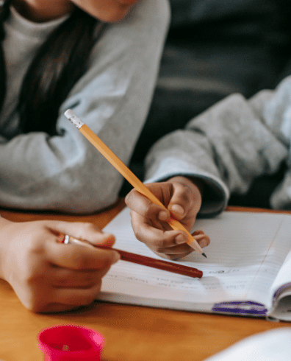
Homework
Life is busy! No pressure to complete.
Several simple tasks in the homework book each half term, usually one per week. Part of this will be to prepare a show and tell. Each child will get to show and tell once per term.
Try to engage your child through play and keep things fun.

Slide 9

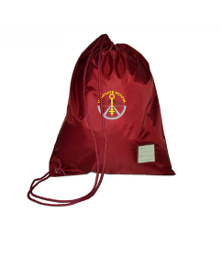

Uniform
Please name EVERYTHING – lunch box, water bottle, ties, every part of the PE kit and uniform, shoes, coats, bags, hats, gloves, snack pots and anything else that is brought into school especially JUMPERS!
Please remove jewellery on PE days and make sure hair is tied back. It is also a really good idea to have spare socks especially in winter months where children may jump in puddles or be wearing tights.
Message from Mr Figg:
“Please ensure children are wearing their ties when they come to school.”

Slide 10

Contact
If you need to let us know anything, you can always send an email to admin@meadgate.essex.sch.uk and this will be forwarded to the year 1 staff members.
You can also write messages in reading logs as these will be checked regularly.
There is also lots of information on school website on the year 1 class page including homework sheets, helpful phonics resources and information about the curriculum.

Slide 11

Any questions?

